Slide 1
Campus mail services
Campus package shipping tutorial

Slide 2
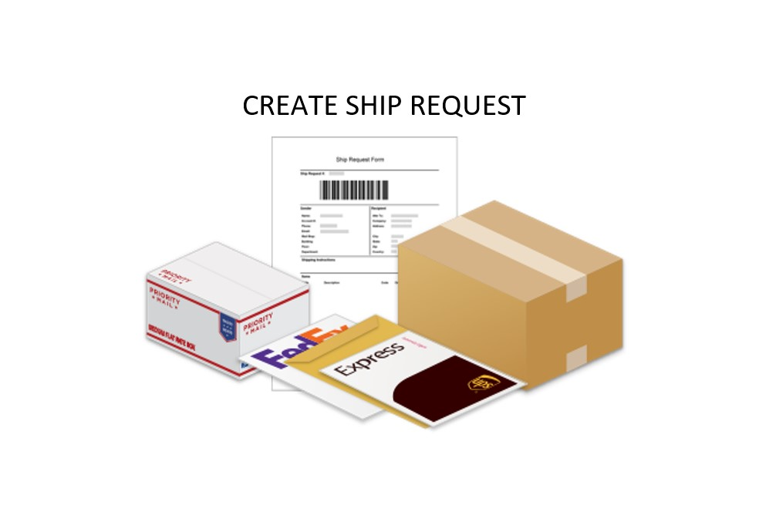
Create your ship request!

Slide 3
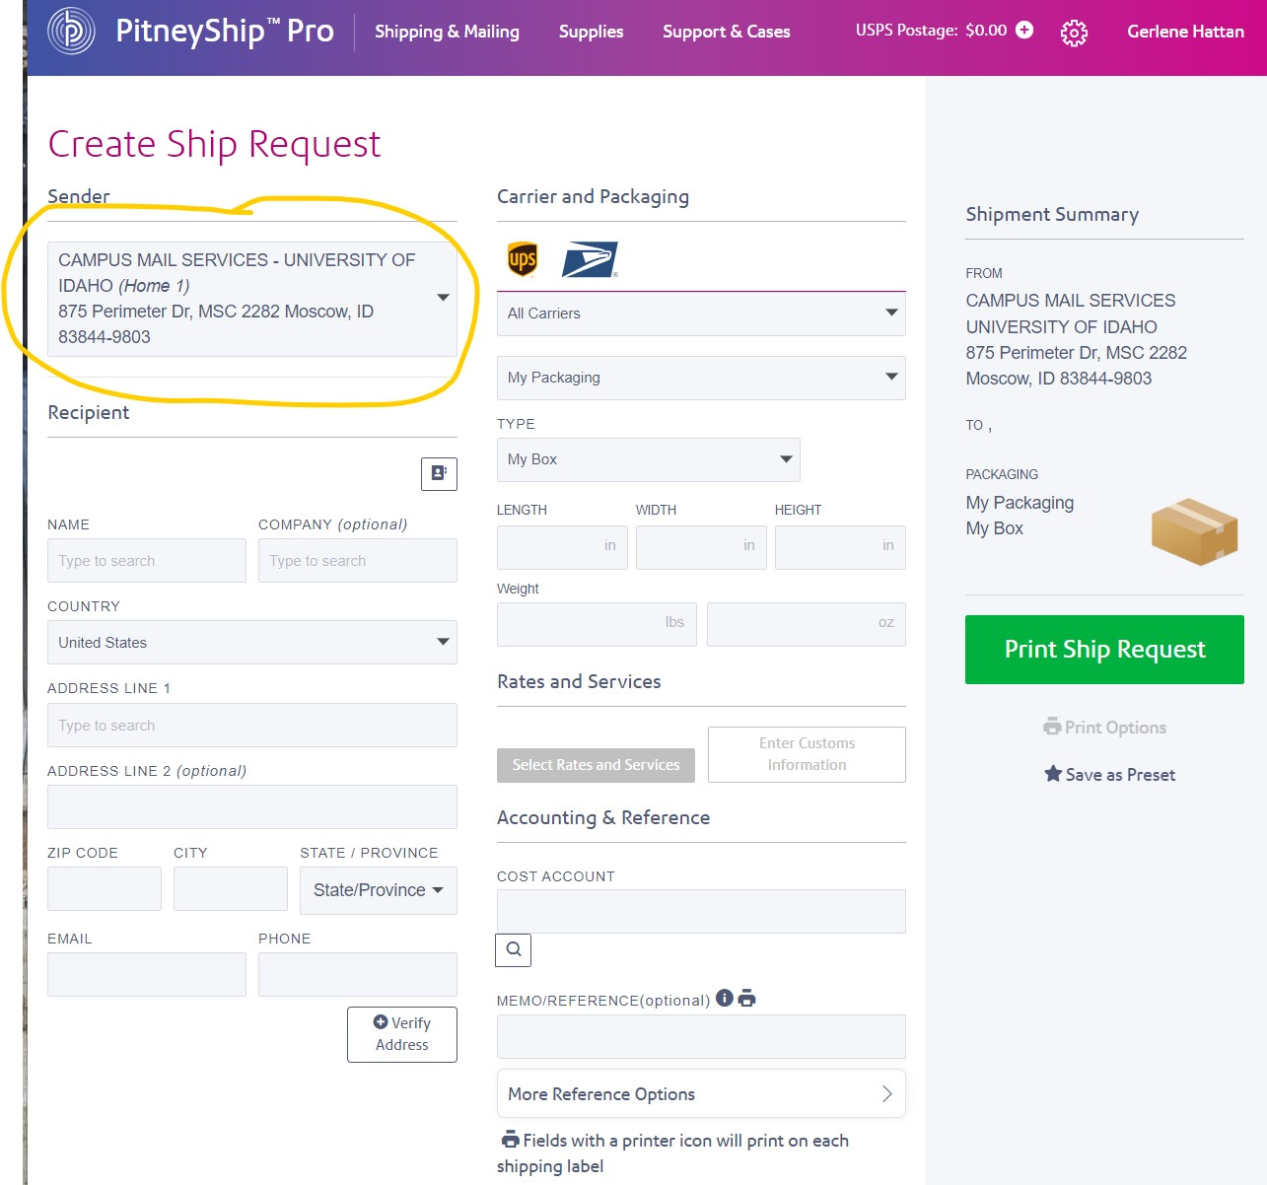
Validate your return address

Slide 4
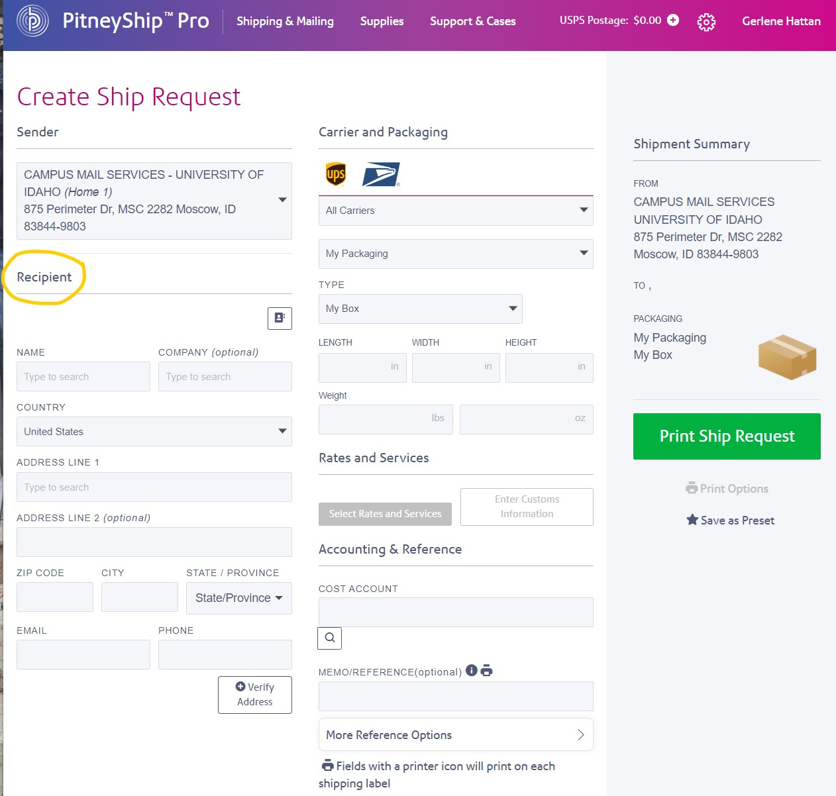
Enter recipient’s address

Slide 5
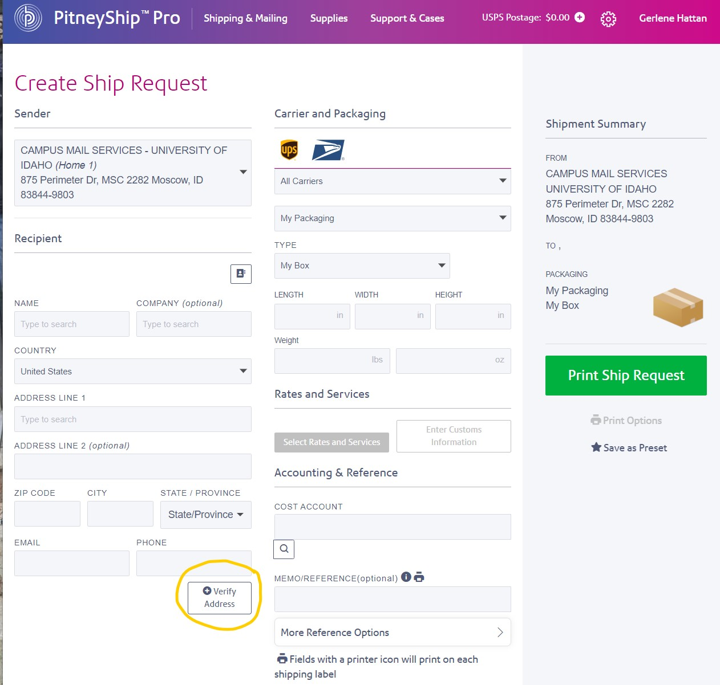
Verify recipient address

Slide 6
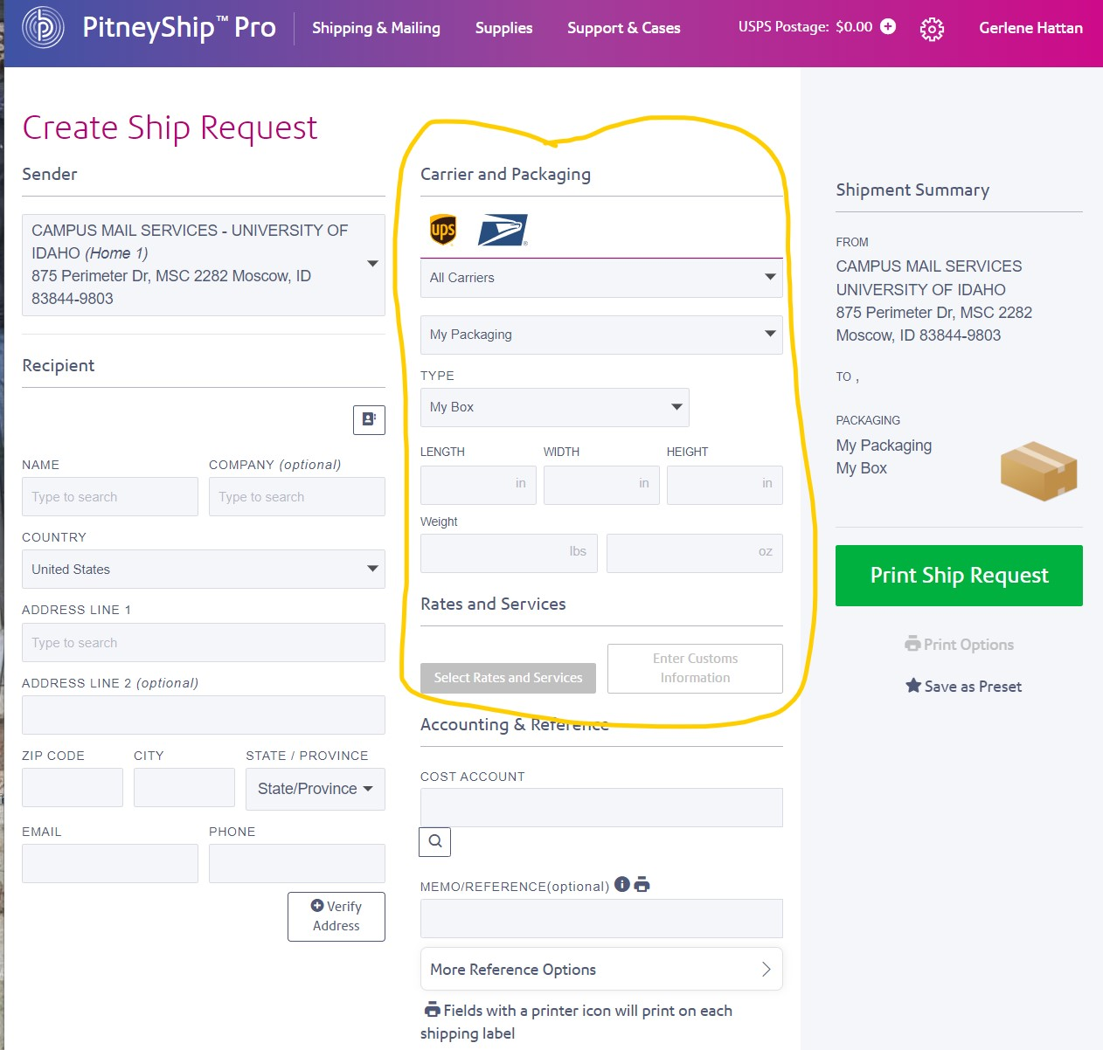
Enter package information & select carrier

Slide 7
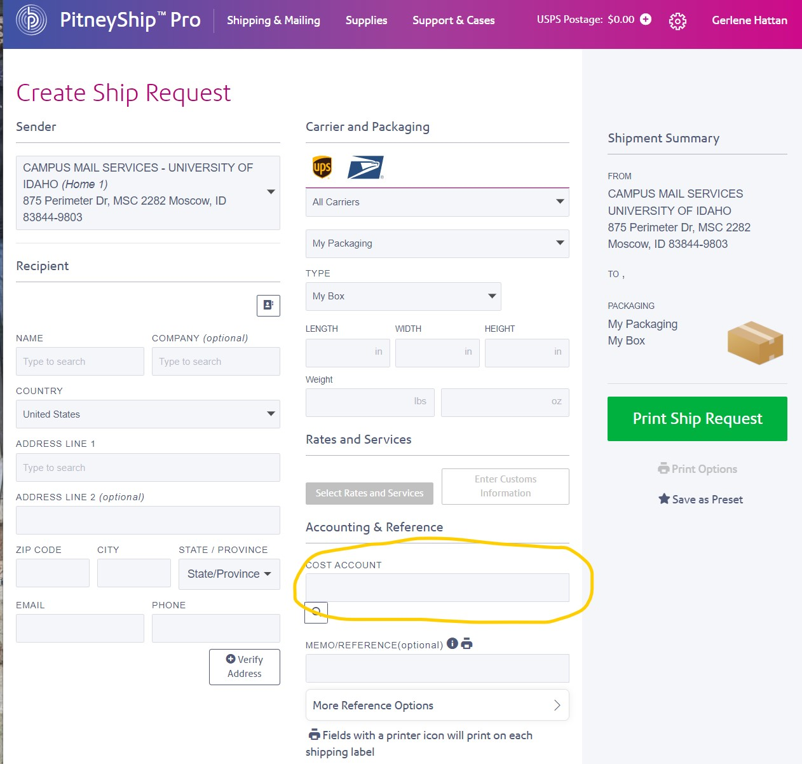
Enter your cost account (index number)

Slide 8
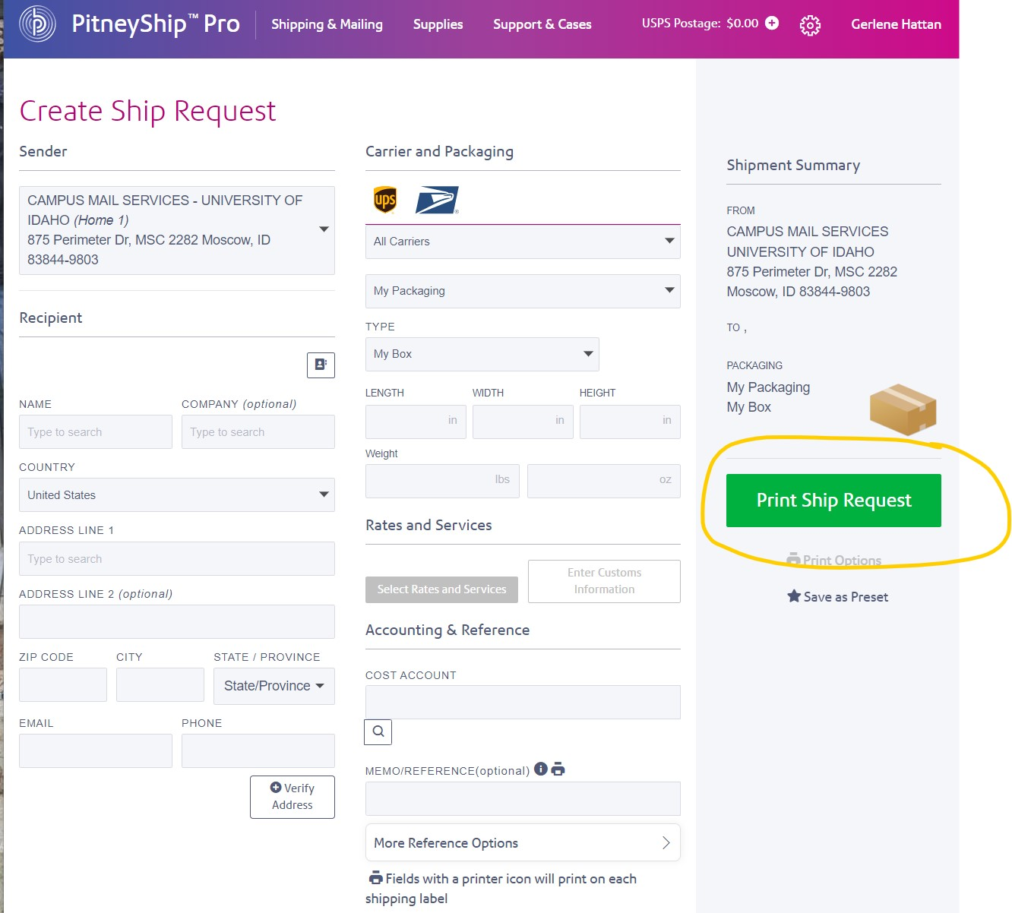
Print the ship request form and attach it to your package

