Slide 1
Vandal Hybrid Budget Model
History and process
White Paper and Working Group charge can still be reviewed at: https://www.uidaho.edu/president/university-working-groups/financial-model
Notes:
Chandra

Slide 2
Hybrid model Categories
Definitions and examples
Category 1: (ex. Advancement)
Category 2: (ex. Division of Finance and Administration)
Category 3: (ex. Utilities)
Category 4: (ex. Student Affairs)
Category 5: (ex. Colleges)

Slide 3
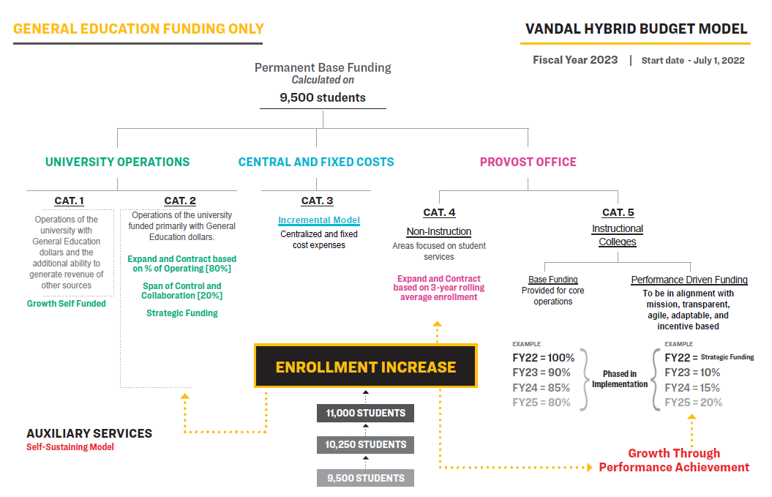
Notes:
Chandra

Slide 4
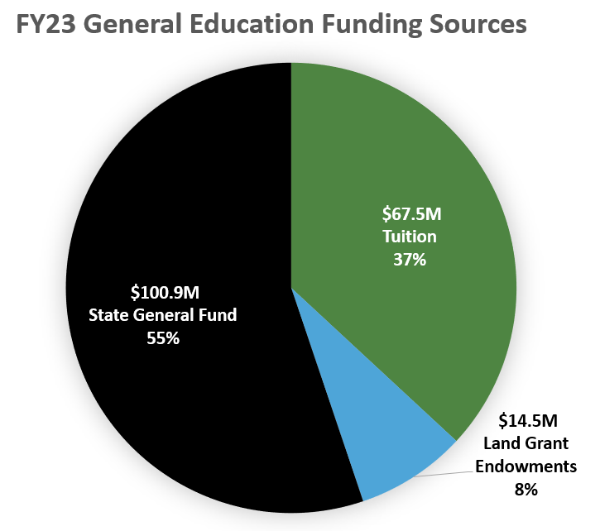
43% of
UI budget
Total Gen Ed
$182.8M
Notes:
Kim

Slide 5
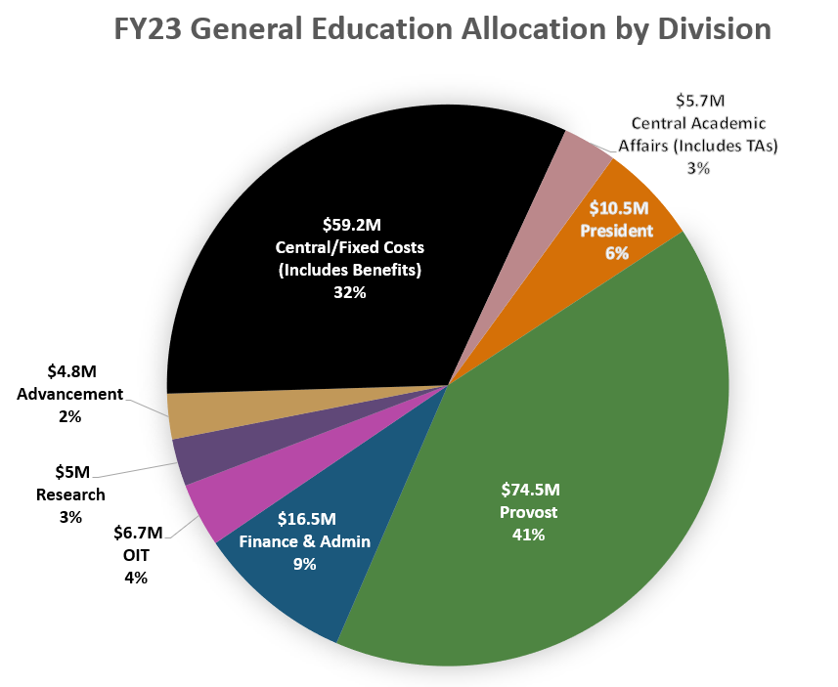
Total Gen Ed
$182.8M
Notes:
Kim

Slide 6
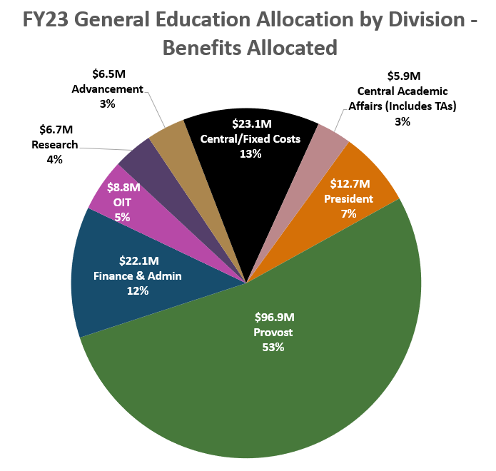
Total Gen Ed
$182.8M
Notes:
Kim
Also – transition to budget model information

Slide 7
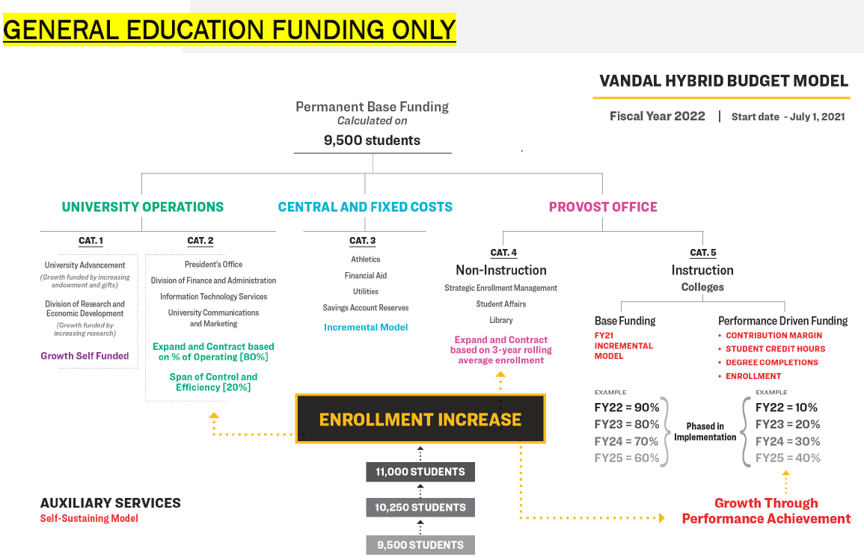
Notes:
Kim

Slide 8
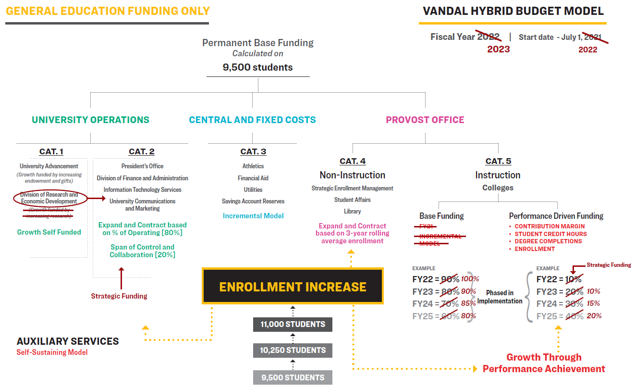
Notes:
Kim

Slide 9
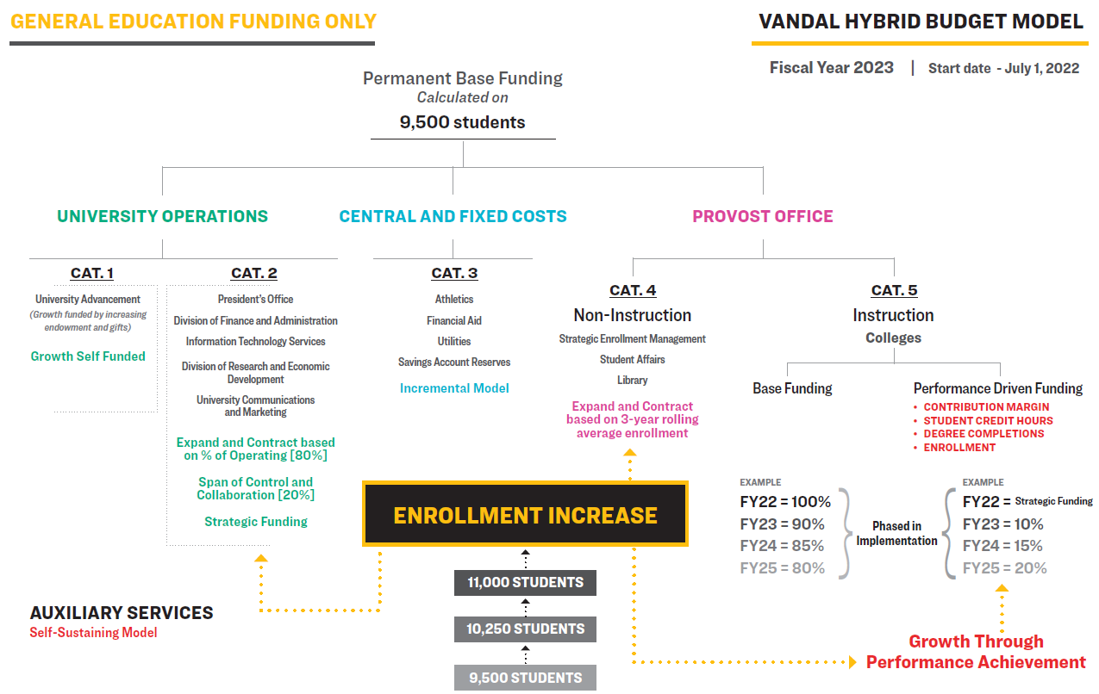
Notes:
Kim
For next year, may keep at 90/10 split

Slide 10
FY24 general Education budget timeline
September 2022 – Requests submitted to Vice Presidents
September/October 2022 – Requests reviewed by Vice Presidents
October 2022 – Preliminary decisions shared with division leaders
July 2023 – FY24 general education funding available
Notes:
Trina

Slide 11
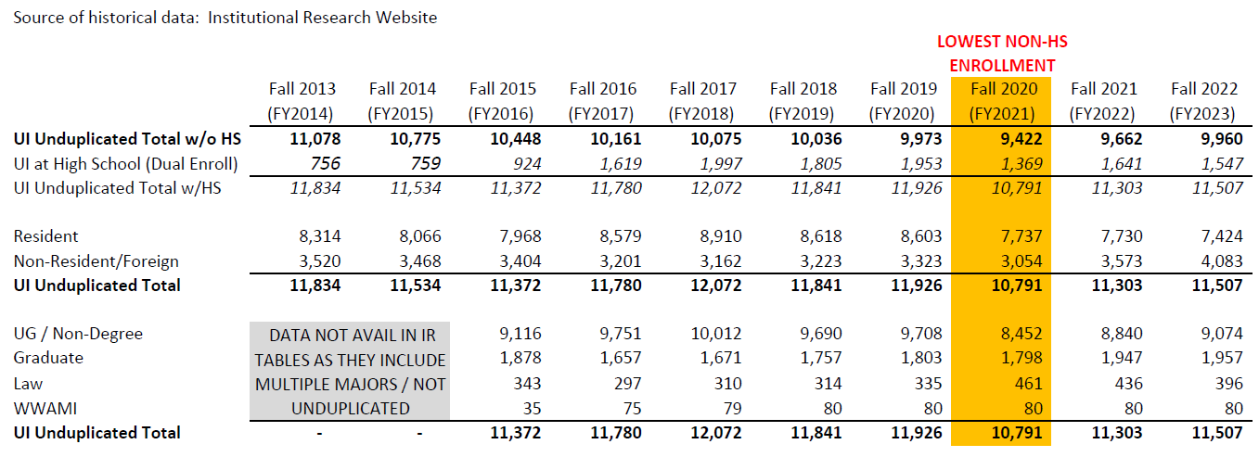
10-year enrollment history
Notes:
Torrey

Slide 12
FY23 General Education Budget
Due to enrollment growth, the University realized $2.7 million in increased revenue during FY22. This is new money that was distributed to divisions in FY23 based on overall budget size and operational obligations as follows:
Category 2: President’s Office, DFA, and OIT – $569,000
Categories 4 and 5: Academic Affairs - $1,431,000
Utility Operations: $700,000
Notes:
Torrey

Slide 13

FY23 General Education Budget
Category 2
Areas measured against targeted efficiency, or customer service, metric and
elimination of unnecessary one-to-one reporting relationships
Strategic funding
President’s Office – $140,000
DFA - $77,000
OIT - $352,000
Notes:
Torrey

Slide 14
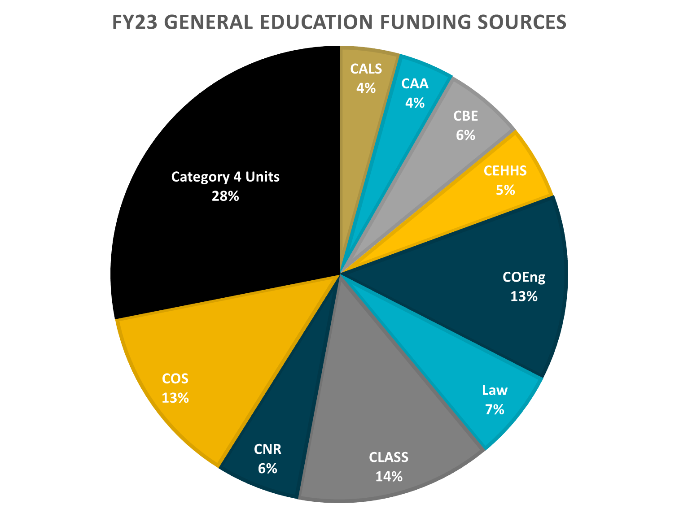
Total Provost Area
$74.5M
Notes:
Torrey

Slide 15
FY23 General Education Budget
Category 4
Funding increase/decrease based on changes in overall enrollment
Increases ranged from 1.8% – 16.1%
Notes:
Torrey

Slide 16
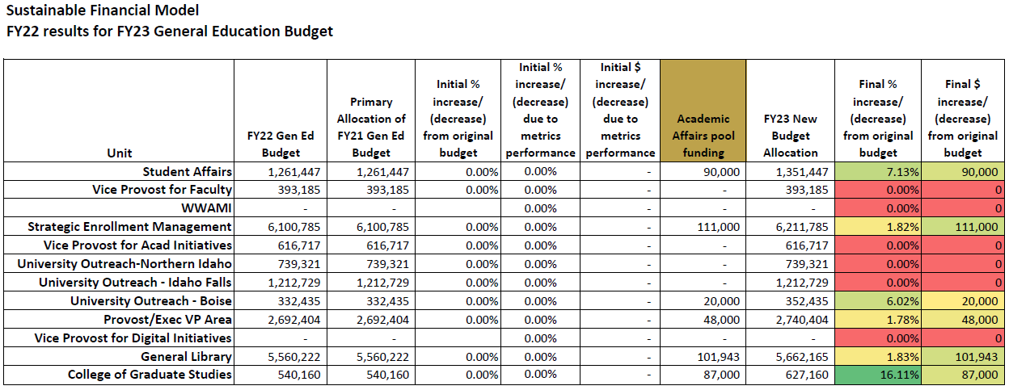
FY23 General Education Budget
Category 4
Notes:
Torrey

Slide 17
FY23 General Education Budget
Category 5
Increases were driven by the metrics we developed
Metric performance resulted in three distinct groups with funding given out as follows:
      Group 1: increases of 5.9% - 7.3%
      Group 2: increases of 0% to 1.07%
      Group 3: no increases, budget remains flat
Notes:
Torrey

Slide 18
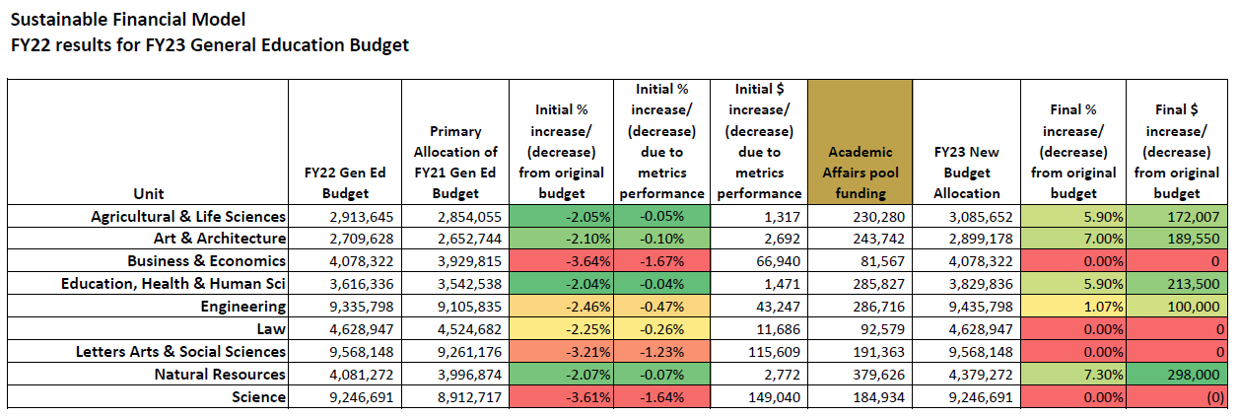
FY23 General Education Budget
Category 5
Notes:
Torrey

Slide 19
FY24 General Education Budget
Category 5
Adjustments from FY23 metrics to inform FY24 Academic Budgets
  Conferral targets: compare FY22 conferrals to previous 3-year average (FY19, FY20, FY21)
  Student Credit Hour (SCH) targets: compare FY22 SCH to previous 3-year average (FY19, FY20, FY21)
  Enrollment targets will stay the same unless re-negotiated
Notes:
Kenwyn

Slide 20
FY24 General Education Budget
Due to enrollment growth, the University realized at least $2.55M in increased revenue during FY23. This is new money will be distributed to divisions in FY24 based on overall budget size and operational obligations as follows:
Category 2: $883,102
Categories 4 and 5: $1,672,326
Allocations within categories will be determined in November 2022.
Notes:
Torrey

Slide 21
Q & A

