Slide 1
Fig Meeting
February 28, 2019

Slide 2
UAT Testing Completed
Thank you for the time and information that each of you provided.
Over all report was that the system will be good – just need time to become familiar with navigation.
Next Step:
Warnings – Will be more defined before the last testing session in March.
The Perdiem calculations still remain an issue that we are working through.
Mileage is linked to Google map
Routing of expenses were determined that more information from the Feeds need to be supplied to CR.
Delegates - more than 2 can be a delegate to complete claims. However, only 1 approval delegate can be assigned at a time.

Slide 3
Purchasing Card Changes to be aware of:
Travel Expenses will need to incurred on the cardholder’s purchasing card or the traveler needs to be on a reimbursable basis. The ability to move expenses from one e-Wallet to another is not available with Chrome River.
If you need to order cards for your area, please allow enough time for the cardholder to complete and pass the Purchasing Card on-line Training.
Please allow a min. of 10 days for the traveler to receive the purchasing card in the mail.
Any expenses after we go live that are not placed on the cardholder’s pcard will be as a reimbursement only.
Clean up is currently being done to remove all inactive pcards and to terminate cards for individuals who no longer are UI employees. Only current employees are allowed a pcard, any exceptions will need to be approved prior to going live because of special handling in Chrome River.

Slide 4
Purchasing Card Expense Reporting
As of April 1, 2019 there will no longer be the bi-weekly downloads for the Z documents or the purchasing card ledgers. From that date forward the information will be included on Chrome River.
During the transition period, we recommend that you reconcile no more than 1 time a week, your choice will be the schedule.
Remember all pcard expenses will now be routed through your Supervisor and the GL approvers – allow time for the approvals and processing time before it appears in Banner.
Travel Expenses may be submitted within 15 days after they returned from the trip.
You can mix pcard and reimbursements on the same claims.

Slide 5
Blanket Travel Pre-Approvals
They will be allowed with restrictions;
During the transition period, we will allow them to be quarterly or for 3 month periods.
The Blanket would be for IN STATE travel only – or the state of your work location.
In the next phase of Chrome River we will be encumbering the pre-approvals, at that time the time frame will be reduced to monthly as a better business practice for NSF management.
Car Rental on Blanket Pre-Approvals – is difficult for the insurance adjustors and Risk Management in claim settlements. The blanket travel authorizations, do not provide specific trip information on the date of the accident compared to a per trip authorization.
A warning will be established in Chrome River for time periods outside of the pre-approval policies.

Slide 6
Group Travel
Situation one:
UI Employee that Is traveling with a group of students or team travel.
The Pre-approval will be for the UI Employee and all expenses will be posted to their pcard, travel advance or reimbursement. No Claims to each individual student or group member.
All expense codes are travel related.
Situation two:
Several UI employees are attending the same conference.
1. Preferred method would be for each employee to have their own pre-authorization and expense claims.
2. If they are all on one pre-authorization, only one name can be listed on the pre-authorization and all expenses will need to be posted on the individual’s purchasing card or reimbursement – not the best practice.
All expenses codes are travel related.

Slide 7
Document Images
The document images for the Travel Expenses and Non Travel Expenses will be stored in Chrome River and will not be available in Stellent.
Images available for viewing attached to each expense during approvals and for review after the report has been completed.
Analytical review of expenses and images will be available for Internal Audit and other areas needed for compliance review.
In the future, further investigation to determine how to transfer the images to Stellent.

Slide 8
Training Sessions
Pre- Going Live
April 4th – Open Fig Meeting for Chrome River training
April 12th – Zoom cast for off campus locations and other areas who were not able to attend the April 4th training.
CHROME RIVER PROVIDES:
Brief training sessions located on the home page of the Chrome River Software.
After G0-Live
2 Open hands on sessions
April 15th 8:30 to 10:00
April 18th 3:30 to 5:00
After that, scheduled training as requested
April 24th Q & A support for Chrome River included in the CUIBO meeting.

Slide 9
Expense Code Discussion
Joe Groves – Asset Accounting

Slide 10
Q & A
Questions and other subjects for the group.
If time allows, a demonstration of the new web pages for additional feed back
Thanks See you April 4th.

Slide 11
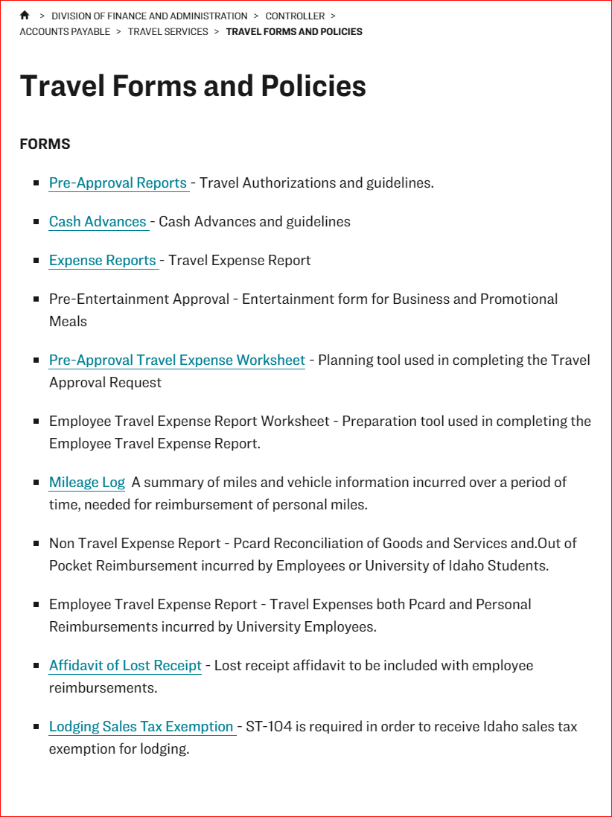

Slide 12
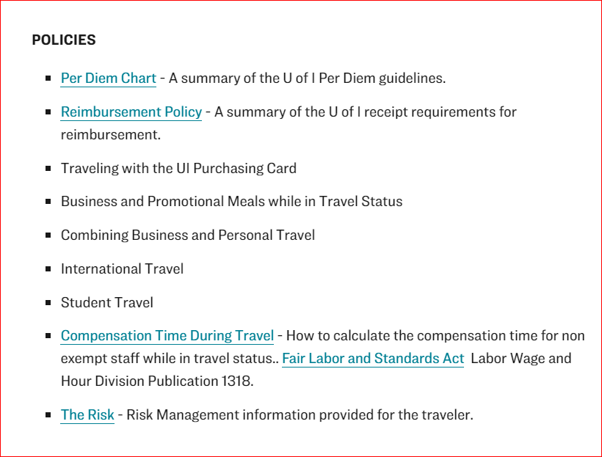

Slide 13
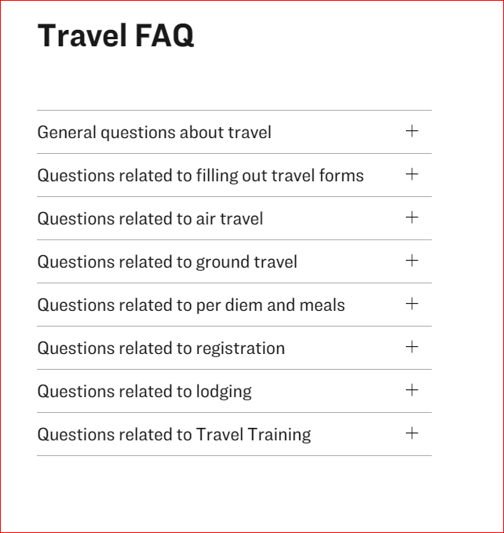

Slide 14
