Slide 1
Fig Meeting
January 24, 2019

Slide 2
Volunteer Training
We’re Searching for Volunteers – Carrie Salonen
Risk Management

Slide 3



Slide 4

Volunteer Opportunities
=
Department Responsibilities
Volunteer working with minors
Employees of another entity for joint research
Student club activities
Comply with Federal Fair Labor Standards
Standards for Departments Using Volunteer Services
Payment of Expenses?
Volunteer’s services offered freely and without coercion
Compensation?
Performers in theatre, music or other productions
Volunteer not skilled for task
Students in a practicum
Volunteer providing transportation
Minor as a volunteer?

Slide 5

Standards for Departments Using Volunteer Services
Compliance assistance
Examples of volunteer activities
Supervisor responsibilities
Approval process
Step by step instruction to The Forms
Records retention

Slide 6


Volunteer Qualification Checklist
Information for Volunteers Form

Slide 7
Volunteer Qualification Checklist
The Basics
Unit
Volunteer’s information (name, address)
Name of volunteer’s supervisor and their job title
Location and dates of volunteer’s service
Specific tasks volunteer will be doing

Slide 8

Volunteer Qualification Checklist
The Referrals
Is the volunteer a UI employee, will they receive compensation,
Is the person a US citizen,
Are they under 18 years of age,
Will they be working with minors,
Will their service take place outside of Idaho,
Will the operate a vehicle,
Will they be in a laboratory environment, or
Will they have contact with animals or genetically modified materials?

Slide 9


Volunteer Qualification Checklist
The Facts
Is another employer paying the volunteer during the dates and times of the volunteer service;
Is the person authorizing the volunteer services and / or supervising the volunteer a family member or cohabitant of or otherwise presenting a potential conflict of interest with the volunteer;
Is the person receiving course credit for their work;
Will the volunteer work under the direct supervision of, or be given the means and direction for the performance of work, by a paid UI employee;
Will the volunteer perform work where there is a legitimate need for services;
Is the work related to the mission or goals of the UI;
Does the volunteer appear to have the skills necessary to perform the work; and
Is the volunteer performing a service that no one is paid to do?

Slide 10
Volunteer Qualification Checklist
If NO REFERRALS to address, print the Volunteer Qualification Checklist certification for Dean or Director’s signature. This is your certification record for this volunteer.
If there are REFERRALS, print the Volunteer Qualification Checklist and contact the unit(s) based on referral message.
If the referring unit(s) authorizes and approves the specifically referred item, print their approval and retain with Volunteer Qualification Checklist. Documentation is ready for Dean or Director’s signature as certification on the Volunteer Qualification Checklist for this volunteer.
Referral items that are not resolved with the referring unit will prohibit the use of the volunteer.
If requester received a notice, "Stop here. Volunteer does not qualify.", the service that the department would like the volunteer to participate in is not eligible for volunteer service.

Slide 11

Information for Volunteers Form
The “information” form is designed to give volunteers important information about volunteering at UI.
After reading the sheet, the volunteer is asked to sign the form to indicate the volunteer has received the information and is an eligible volunteer.

Slide 12

Oh, man! Let’s Get Started
The standards and forms are found on the Risk Management and Insurance web page, under Volunteers or www.uidaho.edu/infrastructure/pss/risk-management/volunteers
Questions?
Visit Risk’s website
Email risk@uidaho.edu
Call 885-7177

Slide 13


Slide 14
Facilities USE Agreement,
Youth Service Programs
Mack DeYoung and Nancy Spink

Slide 15
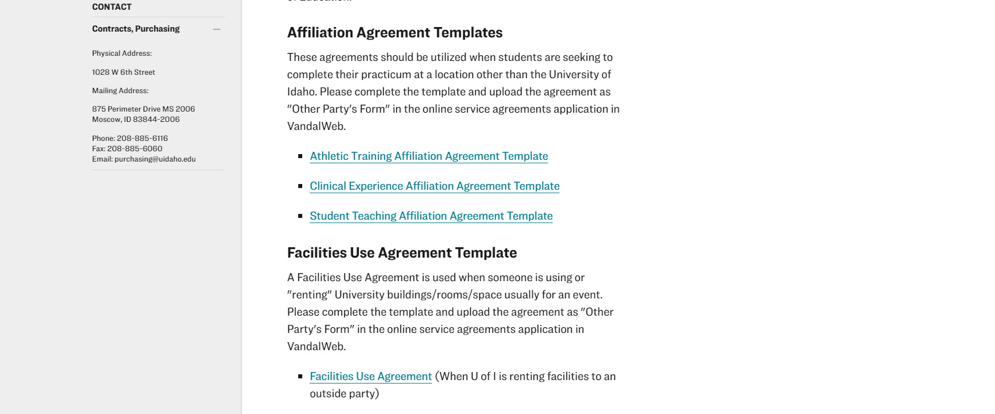

Slide 16
New Travel Web Page Design
Cash Advances
A travel cash advance may only be requested on the Pre-Approval Report prior to submitting for approval. Be sure to allow time for approval, check printing/direct/direct depositing to be completed prior to the departure date of the trip. ******
A Travel advance can be requested as far out as 60 days prior to departure. If expense are incurred more than 60 days before the scheduled trip, an expense report can be created if receipts are provided. Only one advance request per trip.
When Expense are not covered by a purchasing card, 90% of the estimated expense can be advanced.

Slide 17
Which Form Will I be using in Chrome River
Employee Travel Report
Or
Non Travel Expense Report
Claim Voucher Process
Non Employee Payments and Reimbursements.
Students other than GA, RA & TA’s
Affiliate Faculty or Staff
Independent Contractors
Service Agreements
New Employee Moving – Will continue using the Moving Program.
All Employee Travel Reports – both for Reimbursements and Purchasing Cards
All Employee Reimbursements for Out of Pocket Expenses.
Non Employee Purchasing Card Expenses
Purchasing Card Transactions – known now as the “Z documents”

Slide 18
New Wording on Forms
USBANK Application
Employee Applicant requests that he/she be issued a U.S. Bank Commercial Card. Employee Applicant understands that this card is to be used for business charges only and agrees to be bound by the U.S. Bank Cardholder Agreement and the State of Idaho for all charges incurred by the use of the card or the related account.
As the cardholder, the employee is responsible for the expenses placed on the purchasing card and understands that use for personal expenses whether combines with business or intentionally misusing the purchasing card violates the purchasing card polices and may carry legal consequences to the employee.
Employee Applicant Signature Date

Slide 19
New Wording on Forms
Cash Advance Request – Warning when submitting request.
"By requesting a cash advance, I authorize withholding from my pay in the future for any amounts due to the University."

Slide 20
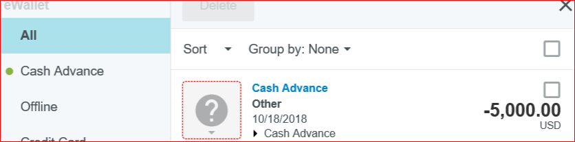
Travel Advances
Travel Advances WILL NOT be placed on the Personal Accounts through Student Accounts.
The Advance will reside in the E-Wallet of Chrome River
Only the amount of the advance that is greater than the expenses will be moved to the Personal Accounts for repayment or possible Payroll deductions.

Slide 21
Tax Forms – Who do you Contact
Employee W2’s and 1042’s - Payroll Services 208-885-3868 or payroll@uidaho.edu
Student 1098T information – Student Accounts 208-885-6539 or deloras@uidaho.edu
Non Employee 1099 Misc. – Accounts Payable 208-885-5379 or lkeeney@uidaho.edu
Please ask them to provide their Vandal Identification Number and a Phone Number that we can contact them – if we are not available.
Remember Tax Information should be handled as confidential information.

