Slide 1
Asset Management
Inventorial Assets: Stand-Alone equipment items that have a cost of $2,000 or more and a useful life of one year or more
Artwork & Collections are evaluated on a case by case basis.
Included Costs: The initial price of the item or items (if constructed), including shipping and handling, applicable taxes, installation and ancillary costs (cords, cables, pipes, etc.) necessary for the item to function for the purpose for which it was acquired
Repairs, betterments or improvements: (a) Extend the estimated useful life; (b) increased capacity; (c) substantial improvements in the quality of output; or (d) substantial reduction in operating cost
Capital Outlay Expenditures: Purchase of equipment where the account code assigned to purchase the item(s) begins with E6*** (Greater than $5K) or E7*** (Less than $5K).
Account code (E-Code) E5*** should NOT be assigned to equipment purchases.

Slide 2
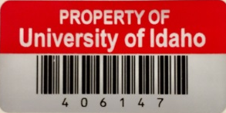
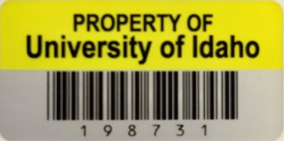
Asset Management
Asset Accounting provides a unique property number for all items included in the fixed assets inventory system that exceed $2K.
Capital Assets are included and exceed $5K
Red Tags identify Grant Funded equipment
Yellow Tags identify all other equipment (excluding vehicles)
The tag number for licensed vehicles begins with a “V”, and trailers with a “T”. The license plate numbers assigned by Idaho Transportation Dept. is assigned in Banner Fixed Assets and will appear on departmental inventory listings run from ARGOS.
Virtual tags are assigned for items such as underground pumps, wheel line irrigation systems, small ITS type switches in closets, etc… (begin with an 8)

Slide 3
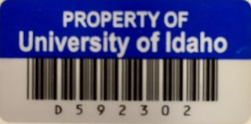
Asset Management
Capital Outlay less than $2K (Blue Tags)
Can be provided for equipment such as computers, flat panel monitors, GPS’s, projectors, HD TV’s, etc. Not restricted to these items.
Blue Tags will be provided upon request ($125.00 for 500 or $25.00 per 100)
Smaller quantities provided at no cost.
ITS and Risk Management can also provide.
Provided as a tool to assist unit tracking & inland marine insurance reporting
Sample Excel spreadsheet is available upon request or available for download on Asset Accounting’s web page.
This equipment is not added to Banner Fixed Assets system

Slide 4
Asset Management
Verification of Annual Inventory
Will conduct a physical verification of inventories as a process of evaluating unit inventory effectiveness.
Normally within 8 months of annual inventory.
Federal Statutes require all grant funded assets to be physically verified every two years.
Conducted to verify the accuracy of records in the Banner Fixed Assets.
Verifies the existence and activity status of equipment.
Provides an overall assessment of the effectiveness of the University’s Asset Management Processes.
Measure the level of compliance with established policies and procedures.
Data used in various other management reports

