Slide 1
FIG MEETING
December 5, 2017

Slide 2
Tuition and Fee Detail Codes Updates

Slide 3
Chart V
New Banner Chart of Accounts – FY19 (7/1/18)

Slide 4
Why the Change?
Banner is a fund accounting program which focus on the source of funds and not the individual departmental organizations.
Standardized reporting capabilities across the colleges and departments.
Banner uses the FOAPAL values in the following way:
Financial resources come from a variety of sources (Funds)
Different groups are responsible for different revenues and expenditures (Organizations)
Each fund may only use its revenues for appropriate expenditures (Accounts)
Revenue and expenditures must be comparable between Universities (Programs)
Activity important to departmental reporting (Activity)
Location of activity or assets (Location)

Slide 5
What is a FOAPAL?
The Banner system’s Chart of Accounts classifies transactions using an alpha/numeric system called a FOAPAL string. UI utilizes the Index field that shortcuts the keystrokes for entering transactions into the FOAPAL string.
F | O | A | P | A | L
Fund | Organization | Account | Program | Activity | Location
Where did the money come from? | Who is responsible for the money? | What kind of transaction is taking place? | How does this transaction compare to other Universities? | Tracking for department-specific activities (optional) | Primarily for fixed asset location identifications.
6 digits Included in Index | 3 digits Included in Index | 4-6 characters | 5 characters Included in Index | 6 characters Included in Index | Included in Index, if used

Slide 6
Index
Used as a short-cut for components of the FOAPAL string to help with data entry
  Currently always fund, org and program
  Defaults values into all forms when used
  Can include activity and location codes (optional but highly recommended)
  Can set up multiple indexes per Org code to allow for multiple activity and/or location codes
Currently you enter index and account (and optionally activity)
INDEX FUND ORG Acct PROG Locn Actv
SFX014 U!1009 SFX014 E5070 07GAX SFXXXXX

Slide 7
New chart you will enter index and account
6 character codes
  In most cases the first 3 are the organization code
  Last 3 are assigned in a one-down sequence
  Will make assigning new codes easier
  The codes will sort in ascending order so the next code will be at the top of a query
INDEX FUND ORG Acct PROG Locn Actv
646910 120417 646 E5070 07GAX ACPSUP

Slide 8
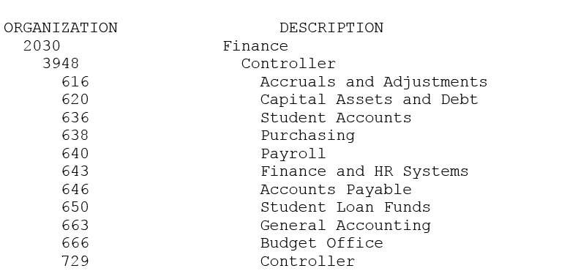
Example: Organizations
Level 2 ➔
Level 3 ➔
Level 4 ➔

Slide 9
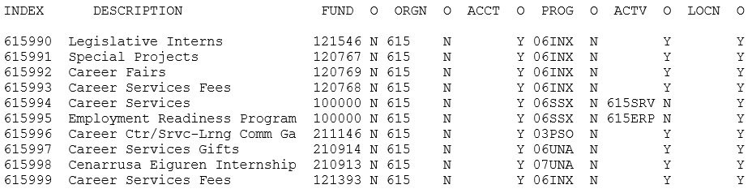
Example: Index Codes

Slide 10
Crosswalk
Indexes and Organizations
Chart 9 Index | Chart 9 Org | Chart V Index | Chart V Fund | Chart V Org | Chart V Prog | Chart V Actv | Chart V Locn
XEX001 | XEX001 | 688999 | 100000 | 688 | 07GAX | 688IEA
XEX003 | XEX003 | 688998 | 100000 | 688 | 07GAX | 688EPR
XEY090 | XEY090 | 688997 | 120741 | 688 | 07UNA
MQ7100 | MQ7100 | 749998 | 160213 | 749 | 01DRO
MQX002 | MQX002 | 749995 | 100000 | 749 | 04ACS
MQX009 | MQX009 | 749994 | 100000 | 749 | 01DRO | 749UGR
Three crosswalks
  Will be used for conversions and
  reference
  Argos queries will be developed to query each
  of the crosswalks
Funds
Chart 9 Fund | Chart 9 Org Ind | Chart V Fund
BNY117 | Y | 150075
BNY155 | Y | 150076
YID016 |  | 120676
YID020 |  | 120684
Accounts
Chart 9 Acct | Chart V Acct
E6520 | E7860
 | E7865
E6610 | E7910
E6620 | E7915

Slide 11
Fund Types and Levels
Fund types categorize the funds at a very high level
  Fund type 1 defines the nature of the funds, such as:
    Unrestricted
    Restricted
    Plant
  Fund type 2 defines the source of the funds, such as:
    General Education
    Sponsored Programs
Fund Levels define reporting hierarchies of the funds
  Federal
  State
  Research
Fund levels go as far as necessary to provide the reporting classifications necessary
  Not all have the same number of hierarchy levels
  Currently using 5 levels
Level 1 duplicates Fund Type 2 to enable online queries at that level
  FGITBSR

Slide 12
Organizations
The “O” in FOAPAL represents the Organization (Org)
  Identifies the group responsible for managing specific buckets of money (the “Who?”)
  Orgs only track revenue, expenses and transfers
  Orgs do not track Cash or other assets or liabilities
  One Org can be associated with many different Funds
  Orgs follow a structure very similar to the University organizational chart
This is not a “budget”. The budget is your spending plan.
Notes:
Organization – in it’s purest form would look like a personnel org chart, with a separate org for every box that represents someone with budgetary authority….so typically at the manager level, although at times may go deeper than that.

Slide 13
Account
The “A” in FOAPAL represents the Account (Acct)
  Identifies the type of transaction (the “What?”)
  Eliminated unused accounts
  Simplified hierarchy
General ledger account codes (assets, liabilities, fund balance) are changing
  Primarily to remove the leading zero to better enable data extracts in Excel
  Numbers will be realigned to make more sense
  Fund balance accounts will change
Operating accounts (expense, revenue and transfers) will remain very similar
  Taxable/non-taxable designation (E and T) has been removed from revenue codes
  Under $5,000 capital accounts will now begin with 7

Slide 14
Programs
The “P” in FOAPAL represents the Program
  Identifies the functional purpose of the transaction for IPEDs reporting and comparability with other Universities
  Follows a standardized system of functional categories prescribed by the National Association of College and University Business Officers (NACUBO)
    Instruction, Research, Academic Support, Student Services...
Program codes are not changing – will be converted as is to the new chart
We are using this opportunity to ensure that proper Program codes are assigned to transactions through Index codes

Slide 15
Activity Codes
The second “A” in FOAPAL represents the Activity
  Identifies a specific program or activity that a department needs to track and may cross over different Funds, Orgs, or Accounts
  Optional and 6 alpha/numeric characters
  Most begin with 3 digit Org code, with the last 3 characters intended to be a short code for the activity title
Most activity codes are now included in the Index to ensure consistent application
  Highly recommended that activity codes, are included in indexes

Slide 16
Location
The “L” in FOAPAL represents the Location
  Used primarily for identifying the location of fixed assets
In the new chart, one unit is using this to define the location of certain activities
Open to use by others after consultation with Controller’s Office

Slide 17
NSF Checking
The NSF process will be simplified
  Three pools will now be used rather than all the primary expenses
    Personnel Expenses
    Subcontract – Grant specific
    All other expenses
Will change look of FGIBAVL
  Will display the three pool accounts only
Primary expense accounts (Account Level 1) will still exist
New dashboards/reports will be created in Argos to view the budget to actual by the primary expense accounts

Slide 18
NSF Checking
Advantages:
  Allow budget plans to remain intact without transferring budget around to avoid NSF between primary expenses
  Reduce the number of budget transfers required
Changes:
  FGIBAVL will not look the same
  Some new reporting for budget exceptions and budget to actual will be created

Slide 19
One-time impacts
YEAR END PROCESSING AND TIMING
  Purchase order roll over of encumbrances from FY 18 to FY19
  Claim Voucher and Invoice deadlines
  Purchasing Card Hierarchy and default budget changes at USBANK
  Travel Advances which carry from FY 18 to FY 19
EPAF processing
Other items as we are aware of them.

Slide 20
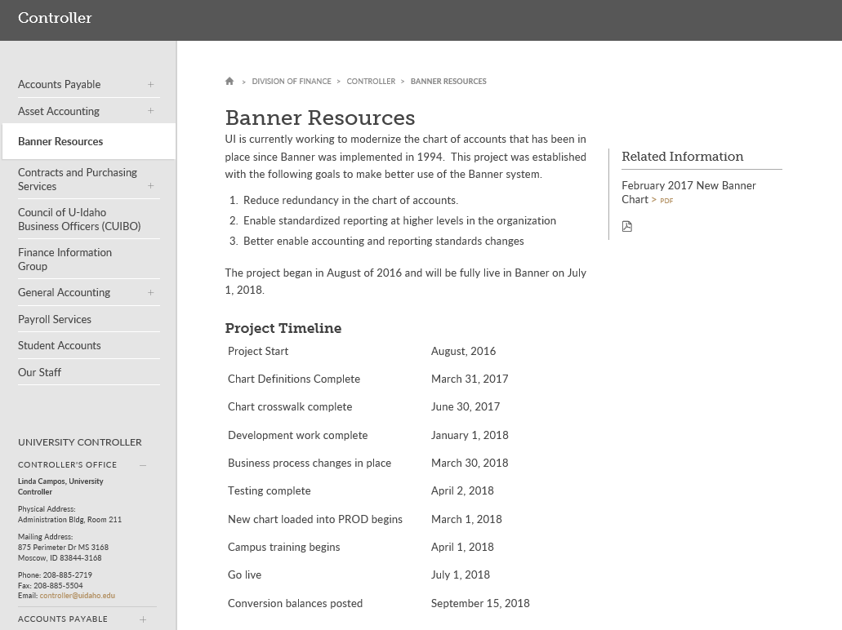
New Home for COA Refresh
https://www.uidaho.edu/finance/controller/banner-resources

Slide 21
Other Business Process Changes
Standardized approval queues
Funds transfer journal entries
Invoice processing and claim voucher system
P-Card reconciliation process
Non-chart project changes coming up
  Banner 9 implementation
  Travel and Expense System

Slide 22
Claim Voucher
Invoice Numbers
Direct Billings

Slide 23
Current Claim Voucher Issues
  Vendor Invoice Numbers
  Dateamount when no invoice number is provided. Typically reimbursements or Individuals.
  Check Remit Area on Form
  Provides the Vendor with information what the payment is for.
  Used for Non Procurement type Items. APM 75.31
Direct Bill Lodging Payments
While it is ok to setup direct bill accounts. The method of payment is the PURCHASING CARD not the Claim Voucher.
Only Meeting and Activity expenses that are greater than 5000.00 should be on the claim vouchers.

Slide 24
Invoice Numbers rules of Consistency
Additional guidelines:
For invoices that have numbers and spaces, always enter the spaces (i.e..,001 456 15789).
If the number is more than 15 characters long, then eliminate the spaces. If more room is needed, count from the right backward 15 characters. Usually the last characters are most important to vendors.
If the invoice number has numbers and letters (i.e., AB 12345), eliminate the space to read AB12345. Another example would be, 1B 457A. This should be entered as 1B457A.
If there is no invoice number listed on the invoice, if there is an Account number on the invoice, use Account number {space} and the invoice date. {For invoice date use format of 121311}.
If there is no account number listed on the invoice, use the date of the invoice, {space} and the dollar amount (i.e., if the invoice date is 12-13-11 for $50.00, use 121311 5000{no decimal} as the invoice number.)
UTILITIES invoice numbers usually consists of Account number and the billing date. Remember, to pay ONLY current charges.
Banner verifies the invoice number for duplicate payments by the invoice numbers.
The Vendor Invoice Number is the actual invoice number printed on the vendor’s invoice.

Slide 25
Holiday Parties
Reminder of the Do’s and Don’ts when Planning your Activities:
Entertainment and Promotional on
AP website:
http://www.uidaho.edu/finance/controller/accounts-payable/promotional-expenses
HAPPY HOLIDAYS
APM Sections 70

