Slide 1
Fig Meeting
March 20, 2018
10:00 AM to 11:45 AM Vandal Ball Room

Slide 2
Announcements:
Risk Managements New Location and mail zip code: TLC, Rooms 48 and 49 Mail stop - 2433
Additional Fig Meeting – May or April?

Slide 3
International Travel Regulations
Dan Lahann – Research Assurance Office

Slide 4
FAMIS CLOUD APPLICATION
Pam Hilliard – Facilities Management

Slide 5
Greetings, I’m Dan LaHann and I’m the compliance coordinator for the Office of Research Assurances (ORA).
Today I wanted to spend a little time explaining export controls and how they tie in with travel web.
“Export controls” generally refers to the complex web of federal agencies and inter-related regulations that govern exports. These rules regulate the transfer of items, software, technology, and/or services out of the United States. As the compliance coordinator for export controls, I am here to assist all faculty, staff and students traveling on official UI business to ensure that they are able to comply with these regulations.
When a traveler indicates they will be traveling abroad, they receive an email indicating that they need to complete some paperwork on the International Programs website. Amongst the paperwork they are filling out are several key pieces that I need as an export control coordinator.

Slide 6
In addition to indicating where they are going and for how long they are going, the traveler completes the University Export Controls Questionnaire. The questions on it are designed to identify specific actions that could trigger a potential export issue and alerts ORA. They do this by inquiring what technology the traveler is taking, if they are aware if the information they will be presenting is publically available or the result of fundamental research, and if you will be working with any militaries or foreign governments. Depending on how the traveler answers the questions, the system will trigger an email to ORA indicating a need to follow up for additional information.
A definition of “Fundamental Research” is defined by the National Security Decision Directive 189 (NSDD189) as “any basic or applied research in science and engineering, the results of which are ordinarily published and shared broadly within the scientific community…” This is important since the Fundamental Research Exclusion states that the results of fundamental research are not controlled by export controls. Under this exclusion, our faculty, staff and students are able to disseminate the results of their research without the need to acquire prior approval from the alphabet soup of government agencies.

Slide 7
The last question on the questionnaire asks if the traveler is visiting an OFAC sanctioned country. There are multiple countries with sanctions, but those countries with the highest levels of sanctions include: Cuba, North Korea, Syria, Sudan, Iran and parts of Ukraine. Unless doing very specific pre-approved activities with these countries, all commercial transactions with them are essentially prohibited.
By having the traveler identify if they plan to visit any of these countries, ORA is able to review their planned itinerary and if appropriate, assist the traveler in preparing the proper paperwork for approval of their activities.
After completing the export questionnaire, the traveler identifies items that they will be temporary exporting. The questions are designed such that if the traveler agrees with what is stated, then the items that they export would be covered under the “tools of the trade” exception which will allow UI employees to temporarily export dual –use (items that could be used for both commercial and defensive purposes) items abroad.

Slide 8
The most common item taken abroad that is a dual use item is a laptop. A quick note: this exception is for the “temporary” export of the items, meaning that the traveler must return to the United States with the item within one year. They also have to keep it under their control and agree not to export it to a sanctioned country (as noted above).
Receiving answers to both the export control questionnaire and to the license exception form help ensure that traveler remains in compliance with export controls. In having the traveler complete these forms in a timely manner prior to departure, ORA has an opportunity to assist them should they require additional assistance in requesting the proper permissions from a federal entity. Your help in ensuring that these forms are completed is greatly appreciated.
I know this information can sound like a lot in such a short amount of time and I would encourage you or any of your faculty, staff or students that have questions about their travel to please contact me at ored-export@uidaho.edu or 208-885-0174 and I will be happy to provide additional assistance.
Thank you for your time!

Slide 9
Updating On Moving Procedures
Julia McIlroy and Linda Keeney

Slide 10
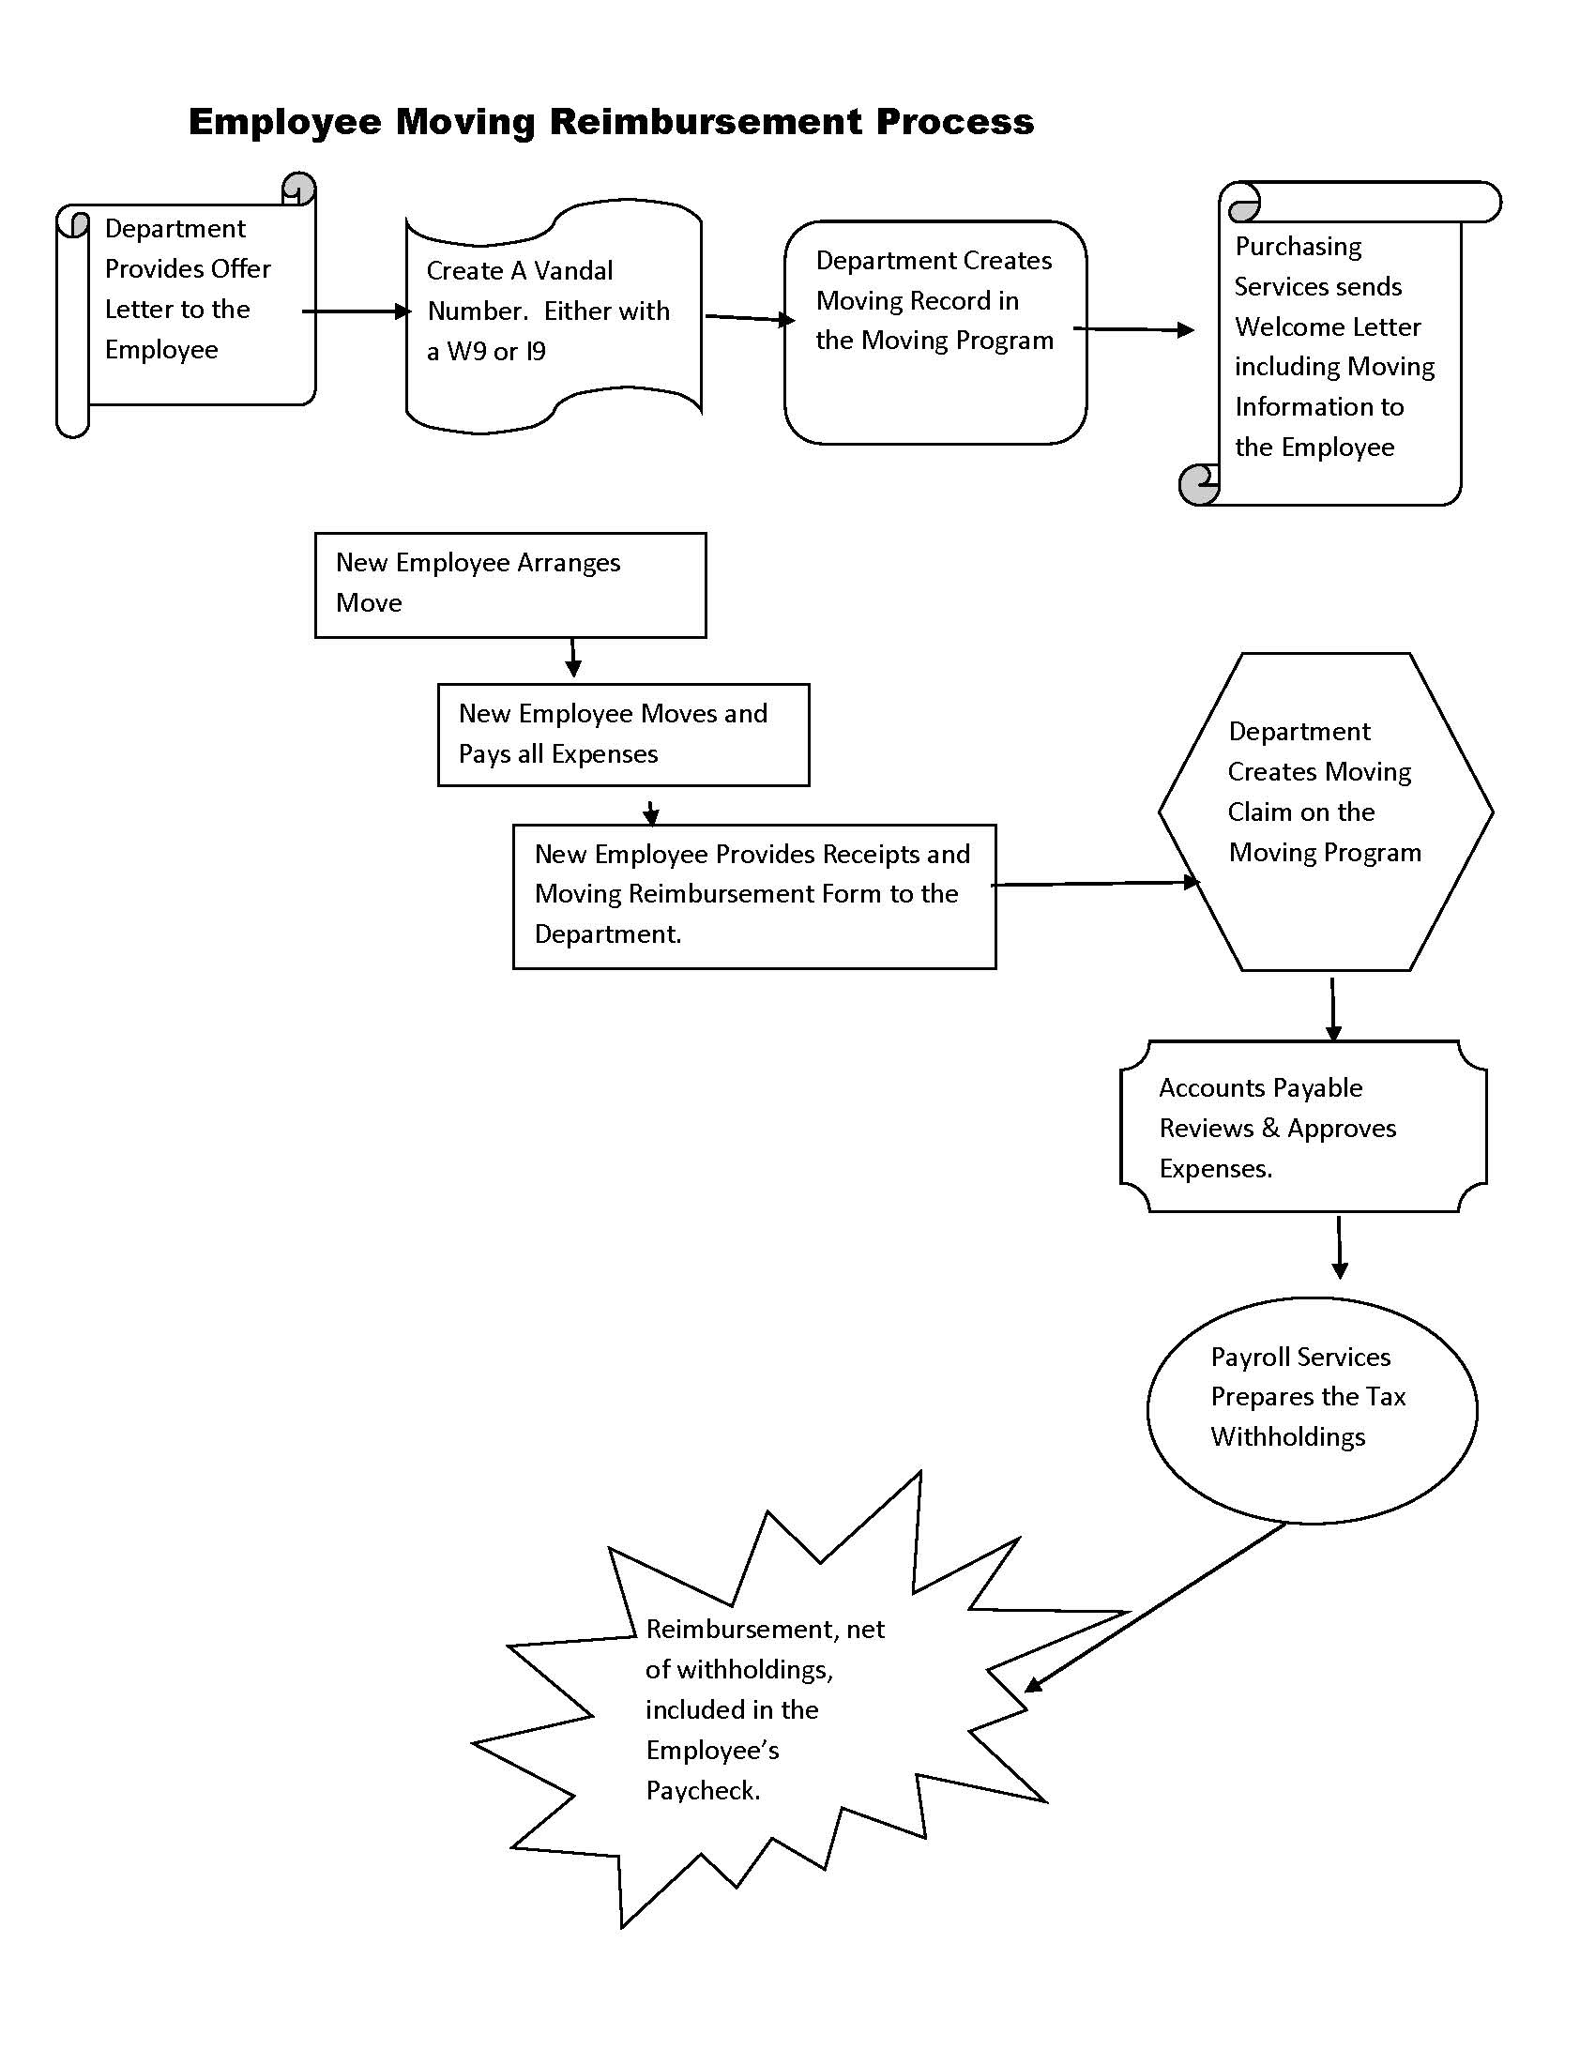

Slide 11
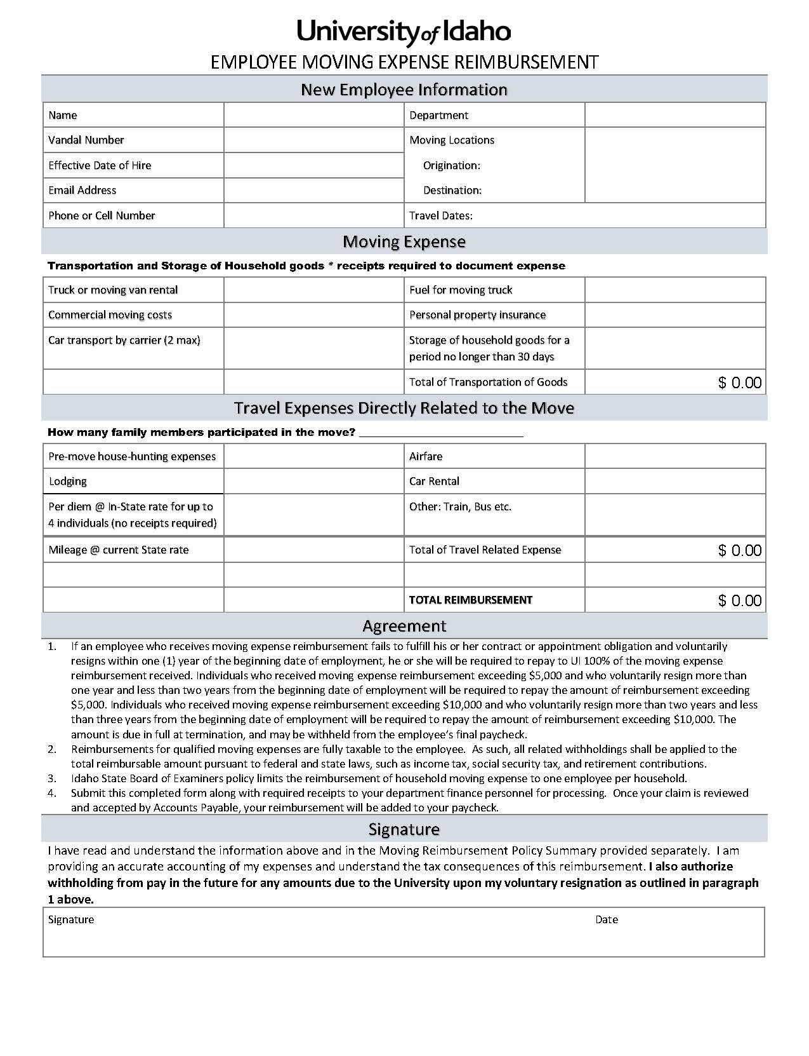

Slide 12
New Moving Expense Code
Moving Expenses will be posted to E4125 as an expense listed in the Salary areas.

Slide 13
Claim Voucher Conversion Training and Timeline
Linda Keeney

Slide 14
FAAINVE Banner Form CV Items Only
Banner Invoice Approval
Payment Processes
AP Review
Scan to
Document Imaging Process
Proposal:
Departments enter Claim Voucher Items directly on Banner Form FAAINVE - CV items only.
Training
Departmental Grouping in April, May and to be completed in June.
Accounts Payable APDOCS
Reason:
Banner 9 compatibility
Chart of Accounts Changes

Slide 15
Cell Phone Stipends
Linda Campos – Linda Keeney

Slide 16
New Cell Phone Stipend Levels
Annual Renewal of Stipend and Review.
Requires a completed application for Cell Phone
Attached Information supporting the level of usage
User for light usage – Monthly Stipend of 20.00
User for heavy usage – Monthly Stipend of 50.00

Slide 17
Chart of Accounts Testing & Training
Ron Town and Linda Keeney

Slide 18
Information to Assist you while testing:
Valid organization codes
  The original org setup was created in early calendar year 2017.
  Orgs created after that time may not be available for testing.
All transactions should be dated July 1, 2018 or later to be posted to FY 19.
JV and invoice transactions have been posted in FY 19.
  Encumbrances balances are currently not available in FY 19.
  Portions of the FY 19 budget entries have not been post.
Test JV numbers are reverse of the original entry
  Reverse to look at the original in FGIDOCR J234567 would be listed as 234567J in FY 19 testing data.
Test invoices start with IX
Payroll/AR transactions don’t have matching payroll records

Slide 19
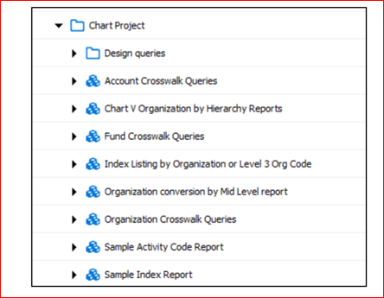
ARGOS Crosswalk queries – Finance/Test/Chart Project
Please try these out. They are not finalized so any input is welcome.
More to come: Budget to actual reporting with a similar look as the current FGIBAVL

Slide 20
How to send Feed Back
Please provide feedback to dfa-chart-project@uidaho.edu
MORE RESOURCES
For more information concerning the Chart of Accounts Refresh:
https://www.uidaho.edu/finance/controller/banner-resources

