Slide 1
Collaborative curriculum development

Slide 2
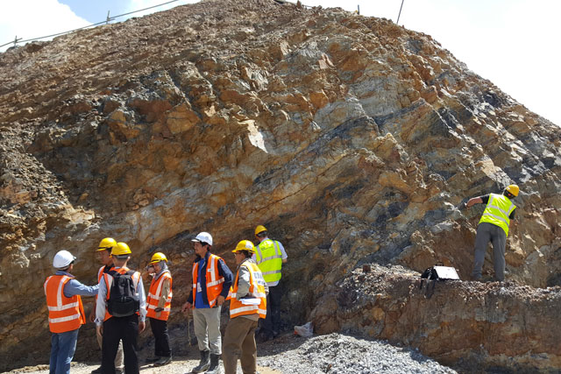
Collaborative curriculum
What do We mean?
Innovative Cross-Disciplinary Degree Proposals
Proposals with 2+ Departments (within or across Colleges)
Could be a University Wide Program (but not limited to)
Example: Proposed B.S. Geological Engineering
College of Engineering: Civil and Environmental Engineering
College of Science: Earth and Spatial Sciences
Notes:
What do we mean about collaborative curricula. Usually, degree programs are from individual departments within colleges.
However, we are seeing that industry are asking for graduates with skills that cross classic disciplinary boundaries.
Collaborative curricula are Innovative curricula that are done in partnership across multiple departments

Slide 3

Industry need
How do we assess NEED
1. Ask Employers
Host Employer Summits
UI Career Fair (arrange networking nights)
In-Person Meetings
Use Advisory Boards
Action: Letters of Support from Industry
Notes:
Employers are a great source of information about need for degrees.
Although you can organize an employer's summit or meet in groups with employers, consider meeting them at the UI career fair or interacting with people on existing UI advisor boards.
If you do create a degree based on their input don’t forget to ask them for a letter of support as these are great at demonstrating o the State Board of Education the need for the program.

Slide 4
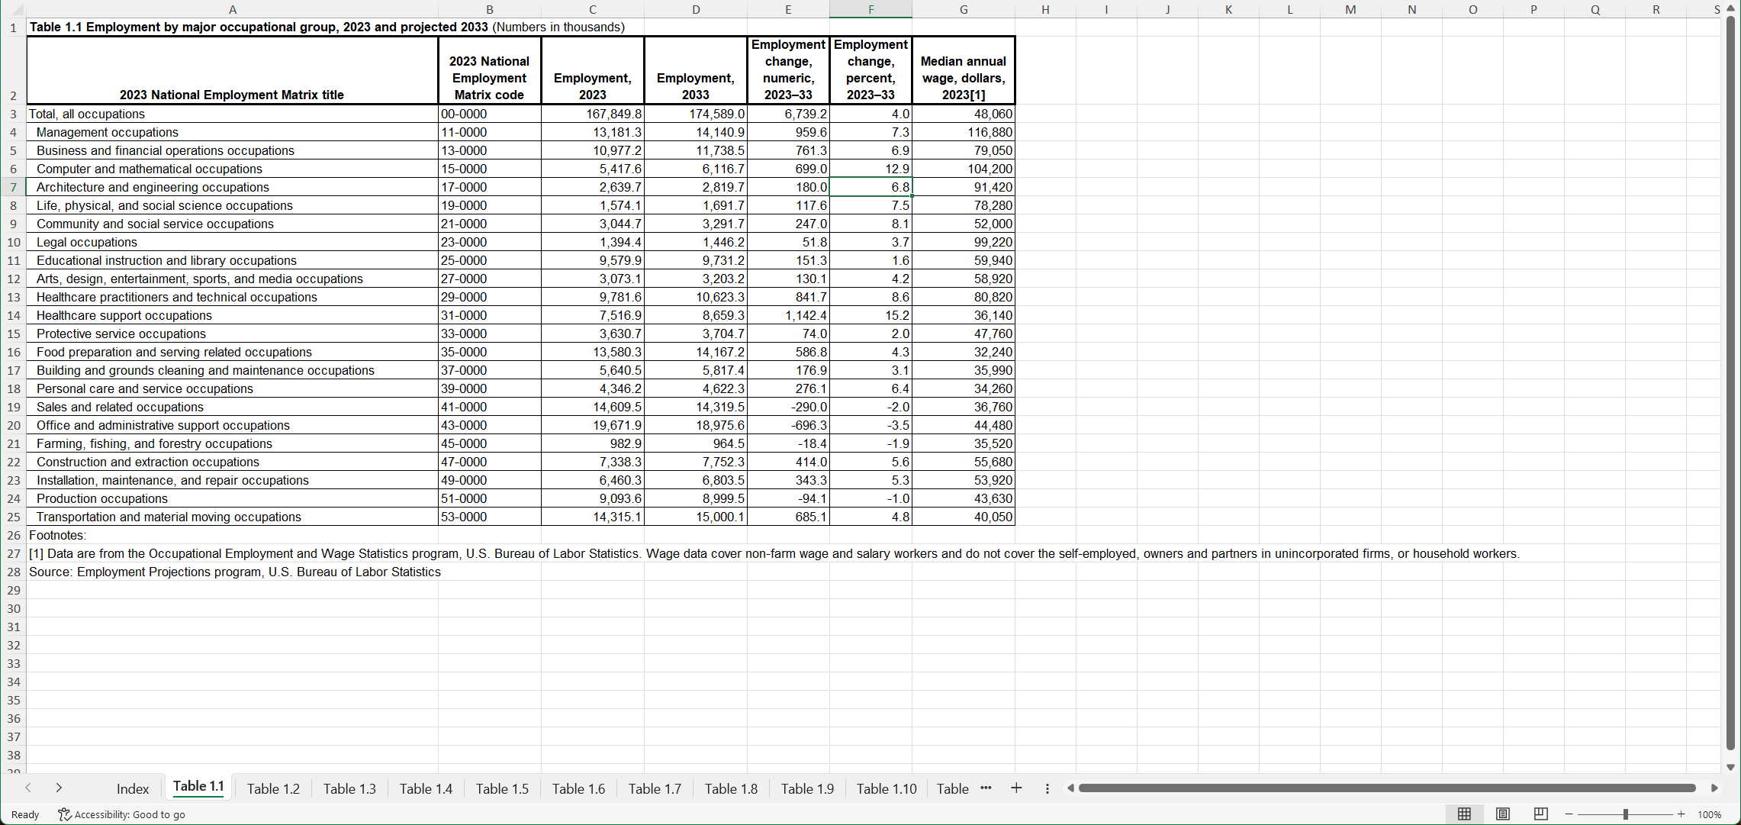
Industry need
How do we assess NEED
2. US Bureau of Labor Statistics Data
10-Year Projections
Change in Actual Employment Numbers
Notes:
https://www.bls.gov/emp/
The website can be very confusing to navigate. This is the data you want:
https://www.bls.gov/emp/tables/occupational-projections-and-characteristics.htm
I have a 2019 version of this spreadsheet

Slide 5
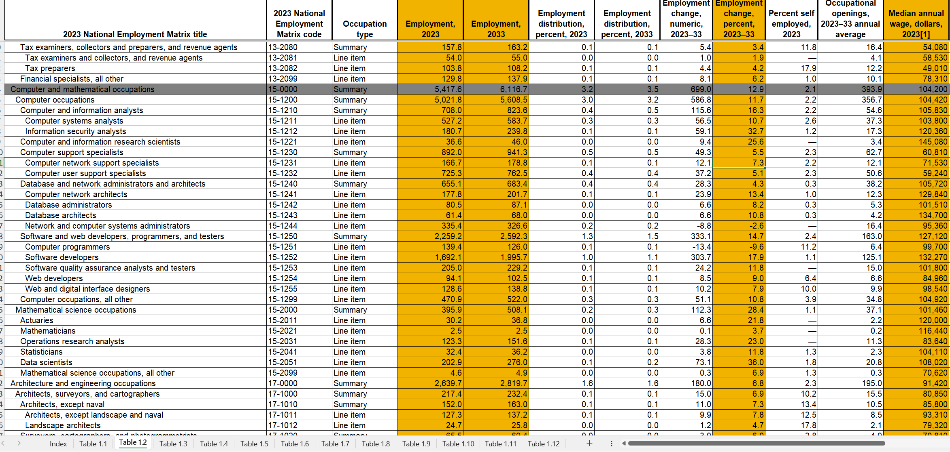
Industry need
2018 Employed: 4674 (thousands)
Actual Increase: +16.9% (exceeded 12.7% projection in 2018)
How do we assess NEED
Notes:
https://www.bls.gov/emp/
The website can be very confusing to navigate. This is the data you want:
https://www.bls.gov/emp/tables/occupational-projections-and-characteristics.htm
I have a 2019 version of this spreadsheet

Slide 6
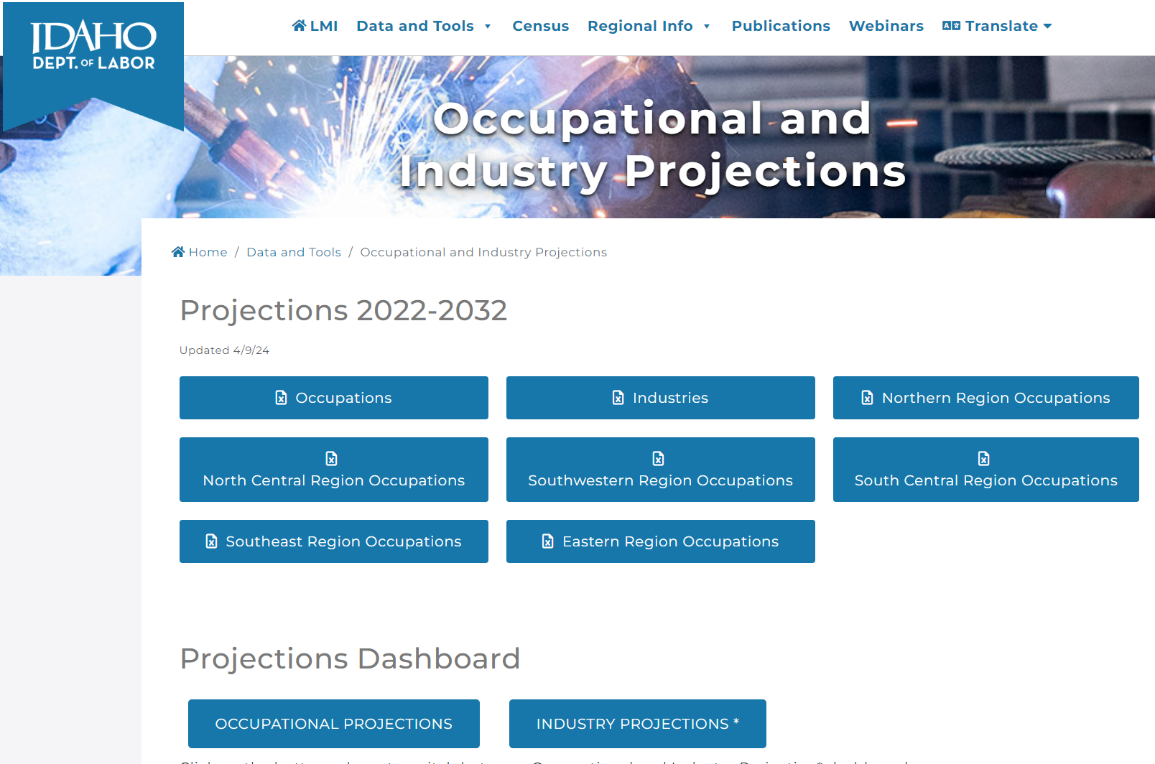
Industry need
How do we assess NEED
3. Idaho Department of Labor
Notes:
https://lmi.idaho.gov/data-tools/occupations-in-demand/
https://lmi.idaho.gov/data-tools/occupational-industry-projections/

Slide 7
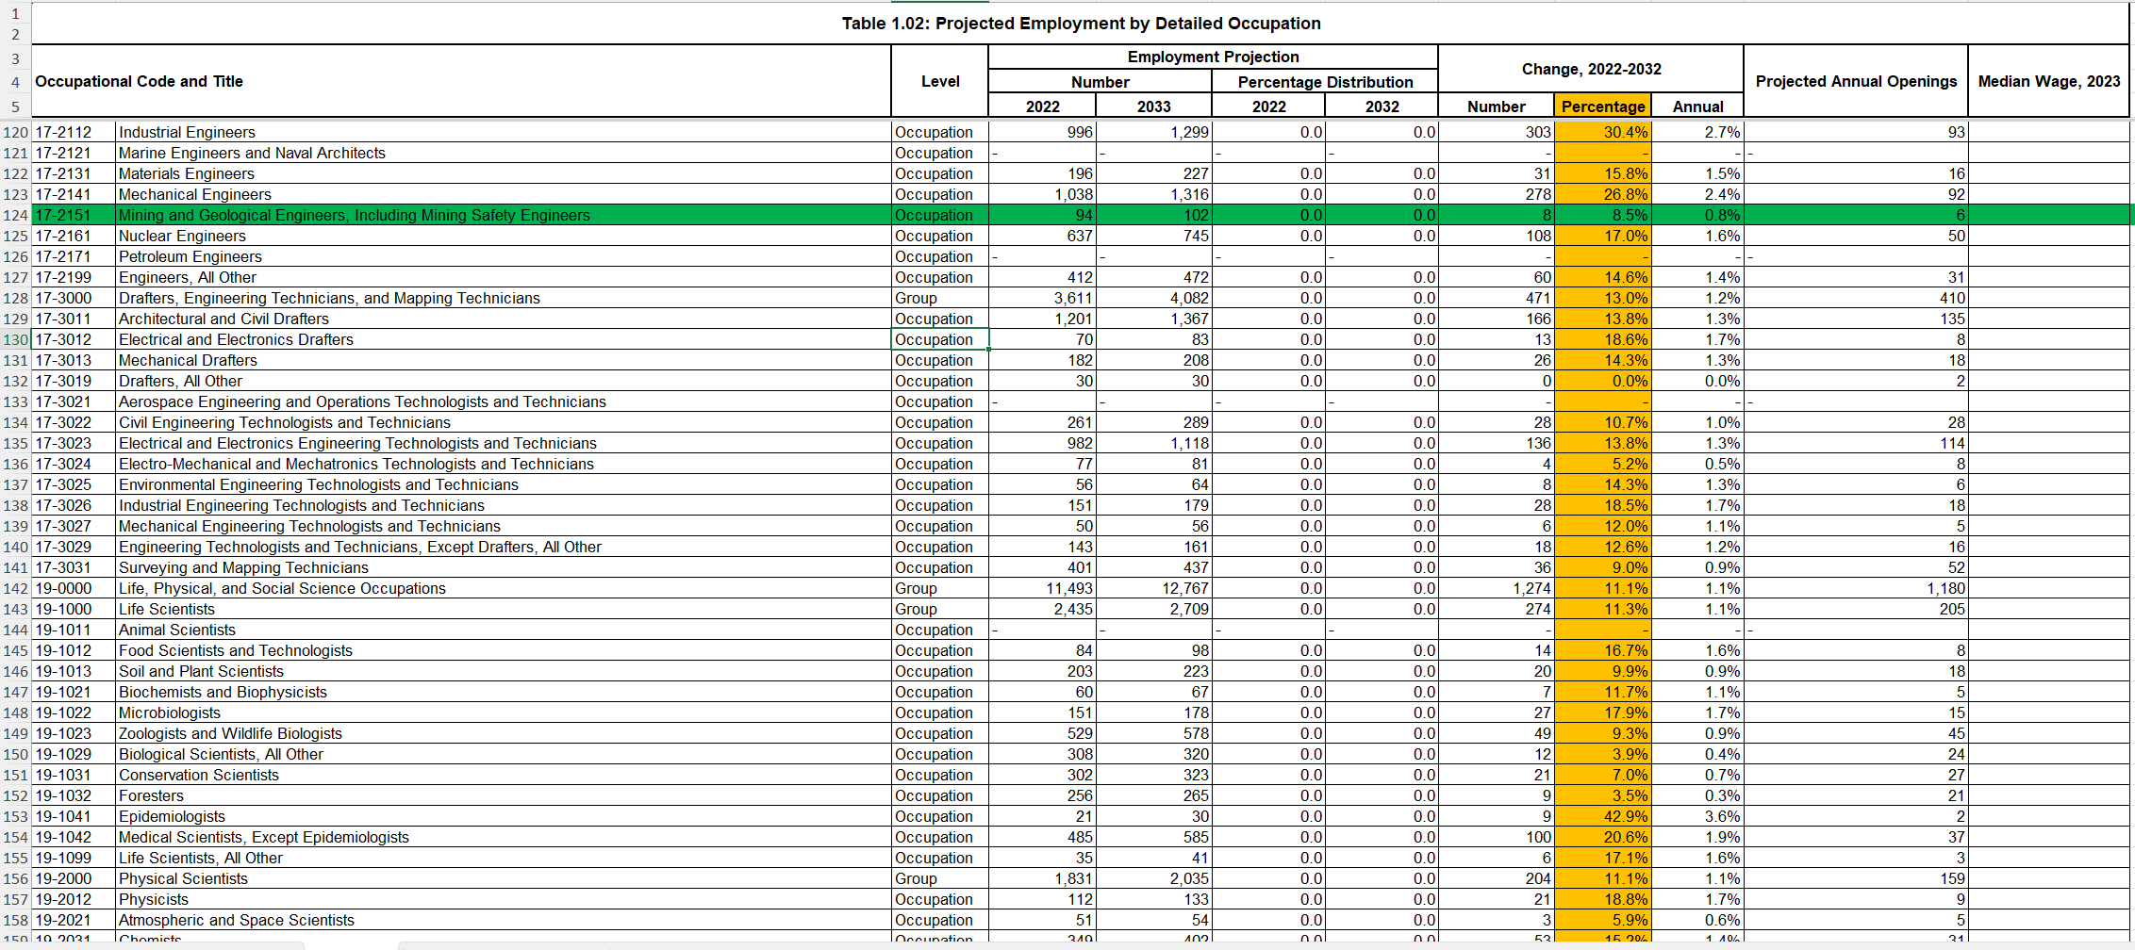
Industry need
How do we assess NEED
3. Idaho Department of Labor
https://lmi.idaho.gov/data-tools/occupations-in-demand/
https://lmi.idaho.gov/data-tools/occupational-industry-projections/
Notes:
https://lmi.idaho.gov/data-tools/occupations-in-demand/
https://lmi.idaho.gov/data-tools/occupational-industry-projections/

Slide 8
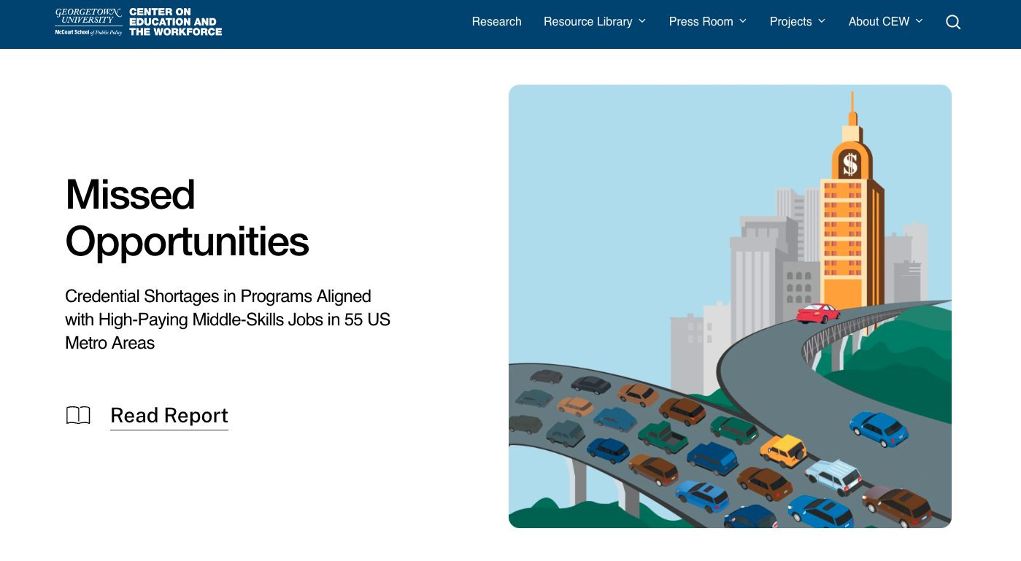
Additional resources
Georgetown University's Center for Education and the Workforce – various reports and data tools: ROI Rankings and Good Jobs Project
Regional eight-year projections, Lightcast report – coming soon on VPAI curricular changes page

Slide 9
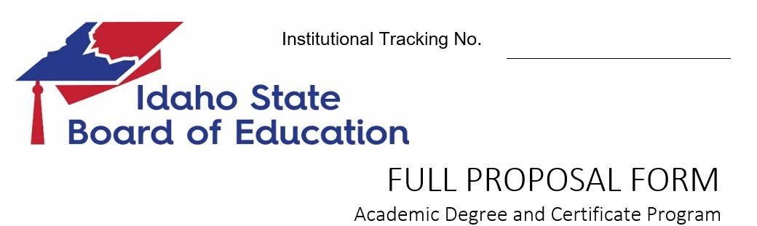
Where this Goes
2. Need for the Program. Describe evidence of the student, regional, and statewide needs that will be addressed by this proposal to include student clientele to be served and address the ways in which the proposed program will meet those needs.
Workforce and economic need: Provide verification of state workforce needs that will be met by this program. Include job titles and cite the data source. Describe how the proposed program will stimulate the state economy by advancing the field, providing research results, etc.
c. Societal Need: Describe additional societal benefits and cultural benefits of the program.

Slide 10
What happens next
Dept Curriculum Committee
Tips to make things go easier:
At UCC/Senate Send Reps From Each Dept
Tell the UCC/Senate Chair About the Degree Early
Include Letters of Support from Industry
  Highlight Demand for Future Graduates
  Aim for 3+ Letters
Don’t Market Program Until After NWCCU Approval
College Curriculum Committee
University Curriculum Committee
Senate
SBOE
UI (Registrar)
NWCCU
Notes:
Don’t these new innovative programs be on the 3-year plan?
Usually that’s ideal, but the State Board odes allow for flexibility if the new program meets an emergent or critical industry/workplace need.

Slide 11
Individual Reflection
Please make notes in response to these questions:
What do you know about industry demand that may be relevant to your existing programs?
What else would you need to know to envision new programs likely to meet industry demand?
Where might you seek the information needed?

Slide 12
Group exercise
Please share ideas around this question:
Can you describe a new degree that integrates the expertise of your department with other department(s)?
Notes:
Please appoint someone as a recorder to summarize your group's take-aways and share them in ~60 seconds during a whole-group debrief session.

