Slide 1
Assessment & Accreditation
Annual Program Review
AY 2023 - 2024

Slide 2
Session Contents/Overview
Presentation Section (please hold questions)
Annual Program Review (APR) timelines
Anthology updates
Meta-assessment update
Request program or college – level assistance
Questions from this section?
Presentation Section (please hold questions)
Overview of review process
Focus on NWCCU’s recommended criterion
Questions about this section?
Presentation Section (please hold questions)
Example UI APR
Anthology Planning Navigation
Questions?

Slide 3
Annual Program Review (APR) timelines
  Review your program(s) for AY 2023-2024
  AY consists of: Summer 2023, Fall 2023, Spring 2024
  Target Completion: Oct. 31, 2024
Colleges – level reviews due Jan. 31. 2025
NWCCU Reviewers on-site end of February 2025

Slide 4
Anthology Updates
Course Evals – Ask your faculty to let me know if they have any courses missing or open/close dates are wrong.
In Outcomes, the AY is displaying as 2023, not 2023-2024. This AY is displaying as 2024, not 2024-2025. Will be fixed.
Curricular changes in effect for AY 2023 – 2024 (your current review period) through Summer and Fall 2024 (next year’s review period) were not updated in Anthology. This has resulted in new programs, program name changes, new courses and associated courses not displaying correctly in Outcomes. Fix planned to run tomorrow, 10/9.

Slide 5
Meta-assessment update
Last meta-assessment report received in 2023 used your AY 2021-2022 APRs
A meta-assessment report has not been compiled in 2024 that would use your AY 2022 – 2023 APRs because the Qualtrics form used is not longer supported and can’t be updated. We are working on a solution.
Request program or college – level assistance
Contact me if you would like assistance more tailored to your program or college.
Christine Slater - cslater@uidaho.edu
Questions so far?

Slide 6
Overview of review process
Complete program review using the assessment template in Anthology Planning.
Ensure assessment results data has been collected in Anthology Outcomes for AY under review – this data will guide your review, reflection, and decisions going forward.
Overview of the planning process
Program planning is a separate process from the APR report. New programs can complete templates in Anthology Planning that describe the program and goals can be set. Planning templates can be updated as program changes are made.
Programs should maintain updated curriculum maps (a plan for which learning outcomes will be measured in which courses and in which semesters). This may change each year and is part of a program’s planning.

Slide 7
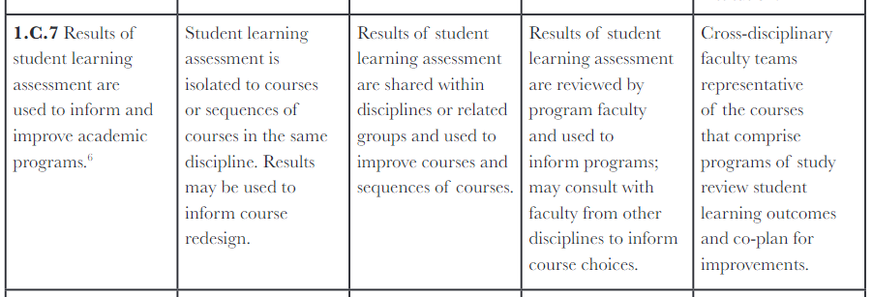
For this review period – focus on NWCCU’s recommended criterion
This is called “closing the loop” and is a practice NWCCU recommends is incorporated into our assessment culture.

Slide 8
What does NWCCU mean by “Results of student learning assessment are used to inform and improve academic programs”? (Standard 1.C.7)
Did the program do the following? Any, some, or all?
Directly references student learning or development
General mention of “use of results,” “closing the loop,” “improvement,” etc.
Mention or description of a change to curriculum
Mention or description of a change to pedagogy or teaching
Mention or description of the need to “re-assess” or determine whether “changes” contributed to actual “improvements”

Slide 9
Anthology Planning – A sample APR
The APR example we will look at is not real and is a conglomerate created from different programs (by permission) or has fabricated narrative for example purposes only.
Questions so far?

