Slide 1

COMPOSTING INTRODUCTION

Slide 2
WHAT IS COMPOSTING?
Composting keeps food waste out of landfills and turns it into a fertile soil additive that helps plants thrive.
The organic material is broken down through aerobic (oxygen-required) digestion, which reduces the overall volume and produces a nutrient-rich material that can be added to soil.

Slide 3




WHY THIS MATTERS
HEALTHY
SOIL
LESS IN LANDFILLS
BETTER PRACTICES
REDUCED EMISSIONS
SAVES WATER
Organic material boosts the nutrient content of soils.
Composting diverts food waste from landfills.
Compost retains water and reduces chemical use.
Compost reduces methane produced by rotting organics.

Slide 4
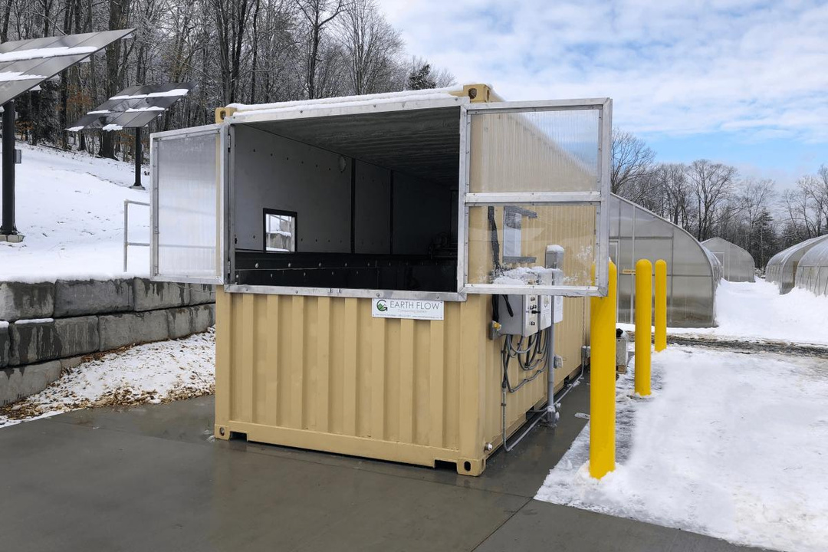
MEET OUR COMPOSTER
Our composting program uses an aerobic digester, which allows us to process large volumes of food waste quickly and accept materials that are otherwise not compostable in backyard piles.

Slide 5




THE PROCESS
KITCHEN DISPOSAL
PICKUP & TRANSFER
IN-VESSEL DIGESTION
CURING & COMPOST
Kitchen staff dispose of food waste into provided bins.
RSSW staff empties the bins into large totes and transfer into the machine.
Wood chips are added to the food waste and begins to break down.
Compost is removed from the machine and left to cure in piles.

Slide 6
HOW TO COMPOST
TRASH
COMPOST
FRUITS & VEGETABLES
MEAT
DAIRY
BREAD & BAKED GOODS
COFFEE GROUNDS
EGGSHELLS
PAPER GOODS
BIOPLASTICS
PLASTIC
METAL
LIQUID
FATS & OILS
BONES >2 INCHES
STICKERS
RUBBER BANDS
WAX PAPER

Slide 7
FAQS
Will there be a bad smell or pests?
Collecting food waste regularly from the kitchens will keep the odor to a minimum. Once the food waste is transferred to the composter, there will be no odor produced thanks to the design of our digester. Pests will not be able to easily access the compost due to the shipping container vessel.
I thought meat and dairy can’t be composted.
Most backyard piles or compost bays do not get hot enough to kill pathogens or break meat down. Our digester is designed to be able to process meat and dairy effectively.
What does “No Liquids” mean?
Compost needs to stay dry and aerated to fully break down. Small amounts of liquid are acceptable, but large volumes of soup, broth, or other liquids used in food preparation should not be poured into the bins.

Slide 8
QUESTIONS?

